Slide 1
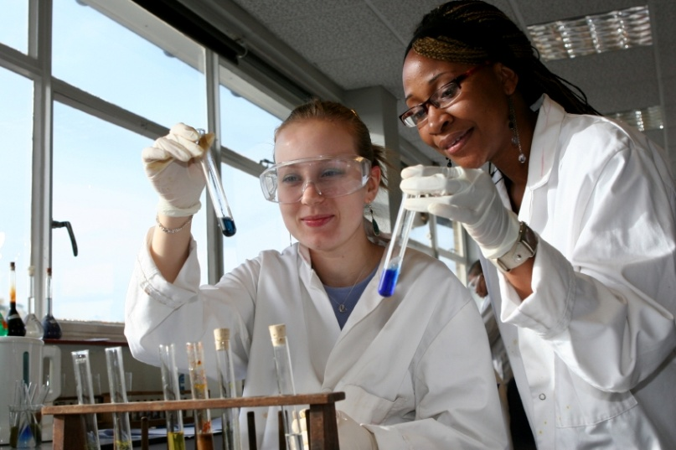
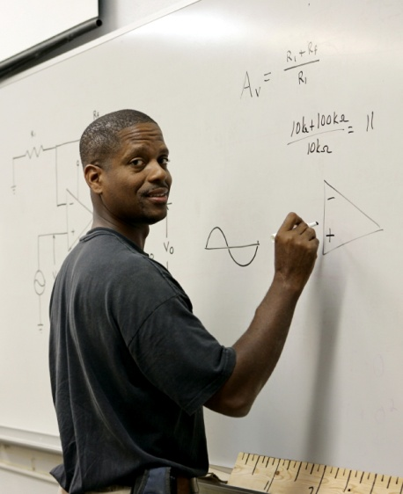
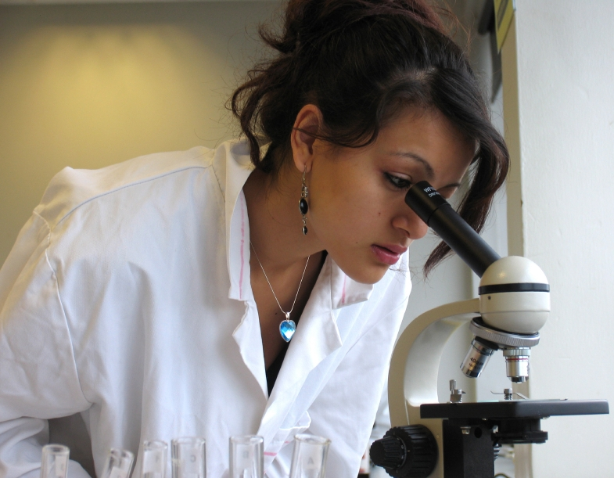
Post-College Pathways: A Longitudinal Study of Biomedical and Behavioral Science Aspirants
Sylvia Hurtado and Mitchell Chang
NIH Interventions Meeting
Burlingame, CA

Slide 2
Key Activities for Year 8
Completed data collection of the Post-Baccalaureate Survey
  Administered to entering cohort of 2004 seven years after college entry
  ~13,500 respondents
Interviewed STEM “pioneers”
  URM and female scientists with national recognition
  Long-term commitment to diversifying the sciences
Administered follow-up survey to students and faculty in introductory STEM courses

Slide 3
Data Collection
Surveys
2004 Freshman Survey
  420,000 students, 720 institutions
2005 Your First College Year Survey
  5,100 longitudinal student respondents, 160 institutions
2008 College Senior Survey
  6,224 longitudinal (TFS) student respondents, 240 institutions
2008 and 2011 Faculty Survey
  More than 10,000 STEM faculty
2010 Classroom Survey
  3,205 students, 76 classrooms
2011 Post-Baccalaureate Survey
  13,500 longitudinal (TFS) student respondents, 500 institutions
Qualitative Data
2007 focus groups with undergraduate research participants and interviews with program directors
  71 students, 12 directors
2010 Focus Groups with graduate students in STEM
  150 students, 6 institutions
2011 focus groups with students in introductory STEM courses; interviews with faculty
  241 students, 26 faculty, 8 institutions
2012 interviews with STEM pioneers
  33 pioneers
Notes:
Follow-up classroom survey had approximately 1,800 respondents with three timepoints of data.

Slide 4
Priming the Pump or the Sieve: Institutional Contexts and URM STEM Degree Attainments
Data from several sources:
  Freshman Survey, IPEDS, National Student Clearinghouse, Faculty Survey, Best Practices in STEM survey
Predictors of URM STEM completion (vs. completion in a non-STEM field)
  Concentration of MD undergraduates (-)
  HS GPA (+), enhanced on campuses where faculty use student-centered pedagogy
  MD aspiration (+); effect reduced at more selective institutions
Predictors of URM STEM completion (vs. no completion)
  % of faculty involving undergraduates in research (+)
  Prior preparation (+)

Slide 5
Faculty Accessibility Cues: Opening the Doors for Classroom Interaction
Mixed methods study using introductory STEM classroom survey data, student focus groups, and faculty interviews
Students sensed a stronger ethic of care from faculty when:
  They felt comfortable asking questions
  They believed the course emphasized applying concepts to new situations
  They received feedback throughout the course
Students sensed a lack of care when:
  They felt overwhelmed by or bored with the course
  Faculty believed unqualified students enrolled in the course
Incorporation of active learning strategies, holding regular office hours/review sessions, and providing regular feedback to students demonstrates care and encourages engagement

Slide 6
Preliminary Findings from “Pioneers”
Agency
Level 1: being mentored
Level 2: self empowerment/self advocacy
Level 3: mentoring others
Level 4: developing programs within institutions
Level 5: developing programs outside of institutional setting
Level 6: sitting on national committees/national offices
“The important thing to realize is that you have at every point, times when you need help. Someone has to appear at that critical moment when you are doubting yourself or getting ready to turn away because you don’t think you can do it or you are confused —at some point, you need someone.”
Institutionalization efforts
Endowments
Training successors
Changing mission statements
Publicizing efforts
Grants or awards or incentives
Long term strategic plans
“One of the things that I think about a lot is whether those efforts can be duplicated somewhere else or if they can continue to exist when that person who leads them is no longer there, because there are lots of people that are very special people that do great things but it’s very unclear any regular mortal can do it.”
Notes:
In the Pioneers study, we explored how key, nationally recognized institutional change agents successfully navigated their way through a STEM career, and how they have changed institutional structures in STEM fields for underrepresented groups.
We’ll just highlight two particularly rich themes. We identified six levels of agency throughout these individuals collective experiences, broadly including how older generations of institutional agents played an important role in the development of participants’ careers in college/graduate school (past agents), how participants functioned as institutional agents in their teaching/research career (agency), and how participants influence others to become institutional agents (influencing others to become agents).
Additionally, the methods of institutional change described by these “pioneers” have implications for how we can continue to promote these efforts beyond the individual, in order to cultivate inclusive environments and foster success in STEM fields.

Slide 7
Plans for the Final Year
Analyze, Analyze, Analyze!
  Delve into post-baccalaureate survey data
  Examine long-term effects of introductory STEM courses with final follow-up survey from spring 2012
Disaggregate, particularly with regard to completion
  By Race
  By Field
Complete book
  Will summarize findings of the last eight years
  Will focus on talent development, structures of opportunity, and how race matters in STEM

Slide 8
Challenges and Lessons Learned
Challenges
  Response rates
  Incredible amount of data
Lessons learned
  Incentives and early outreach helped in final year of data collection
  Hire a strong team

Slide 9
Journal Publications AY 2011-2012
Gasiewski, J.A., Eagan, K., Garcia, G., Hurtado, S., &Chang, M.J. (2012). From gatekeeping to engagement: A multicontextual, mixed method study of student academic engagement in introductory STEM courses. Research in Higher Education, 53(2), 229-261.
Chang, M. J., Eagan, M. K., Lin, M. L, & Hurtado, S. (2011). Considering the impact of racial stigmas and science identity: Persistence among biomedical and behavioral science aspirants. Journal of Higher Education, 82(5), 564-596.
Eagan, K., Chang, M.J., Hurtado, S., Garcia, G., Herrera, F., & Garibay, J. (under review). Making a difference in science education for underrepresented students: The impact of undergraduate research programs. American Educational Research Journal.
Chang, M.J, Hurtado, S., Sharkness, J., & Newman, C.B. (under review). What matters in college for retaining racially underrepresented scientists and engineers. Journal of Research in Science Teaching.

Slide 10

Contact Info
Faculty/Co-PIs:
Sylvia Hurtado
Mitchell Chang
Postdoctoral Scholars:
Kevin Eagan
Josephine Gasiewski
Administrative Staff:
Dominique Harrison
Graduate Research Assistants:
Tanya Figueroa
Gina Garcia
Juan Garibay
Felisha Herrera
Bryce Hughes
Papers and reports are available for download from project website:
http://heri.ucla.edu/nih
Project e-mail: herinih@ucla.edu
This study was made possible by the support of the National Institute of General Medical Sciences, NIH Grant Numbers 1 R01 GMO71968-01 and R01 GMO71968-05, the National Science Foundation, NSF Grant Number 0757076, and the American Recovery and Reinvestment Act of 2009 through the National Institute of General Medical Sciences, NIH Grant 1RC1GM090776-01. This independent research and the views expressed here do not indicate endorsement by the sponsors.

