Slide 1

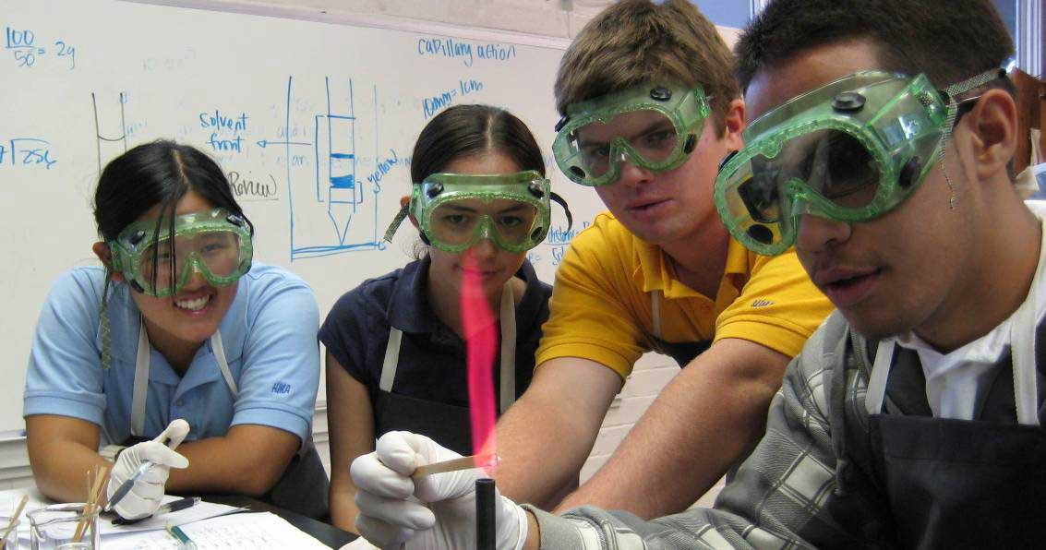
Supporting Future Scientists: Predicting Minority Student Participation in the STEM Opportunity Structure
Tanya Figueroa, Bryce Hughes, and Dr. Sylvia Hurtado, UCLA
NARST, Rio Grande, PR, April 2013

Slide 2
Introduction
URM students face multiple barriers in STEM
And even the best prepared students are often pushed out of STEM
Research has identified a number experiences that facilitate success in the face of these barriers – the “opportunity structure” in STEM programs
Is there differential access and participation in these activities?
Notes:
TF
Barriers –
More likely to question their academic ability due to negative stereotypes about URM students
Difficult for URM students to feel a sense of belonging within STEM programs
These factors make them more vulnerable to attrition in the face of personal burdens
Various extracurricular and co-curricular activities are associated with greater academic achievement, retention, and persistence.
Such co-curricular activities comprise what we refer to as the “STEM opportunity structure,” because they support and enhance students’ participation in a STEM major, serve as pathways into STEM-related careers, or motivate students to pursue graduate work.

Slide 3
Purpose
Purpose: To identify predictors that affect the likelihood for STEM aspirants to participate in the STEM opportunity structure:
  Undergraduate research programs
  Supplemental instruction
  Major-related clubs or organizations
  Internship programs
  Faculty mentorship and support
Notes:
TF
PURPOSE: Identify the individual and institutional factors that affect the likelihood that science oriented students will have access to and/or become involved in key co-curricular experiences during their undergraduate career.
These are all part of the STEM opportunity structure because they function as interventions, that provide both academic enrichment along with peer and/or faculty support. Most importantly prior research has determined how these practices on college campuses are linked with retention in STEM fields.

Slide 4
Literature
Research shows that the five co-curricular activities we investigate in this study benefit students as they:
  Socialize students into STEM
  Increase their confidence and skills
  Clarify educational and vocational goals
  Strengthen aspirations to enter a STEM career or graduate program
  Provide social support and professional development
Notes:
BH
In this slide we provide a brief overview of the research regarding undergraduate research, supplemental instruction, major-related clubs and organizations, internships, and faculty mentoring.

Slide 5
Literature (cont)
Activities also associated with numerous academic outcomes including:
  Opportunity to overcome challenges posed by poor high school preparation
  Increased academic performance
  Strengthened commitment to STEM
  Improved retention and persistence in STEM
Participants more likely to get a STEM-related job after graduation.
However, these opportunities often end up being reserved for “rising stars”
Notes:
BH

Slide 6
Methods
Data source and sample:
  2004 CIRP Freshman Survey
  2008 CIRP College Senior Survey
    6224 students at 238 institutions
    Longitudinal response rate: 23%
  Institutional data from IPEDS
  Sample: STEM aspirants
    4046 students at 212 institutions
Analysis
  Hierarchical linear modeling (HLM) and hierarchical generalized linear modeling (HGLM)
Notes:
TF
TFS: collects demographic information and information about students’ precollege experiences, attitudes, values, goals, self-perceptions, and expectations for college.
CSS: collects information about the experiences students had while in college as well as their self-perceptions, values, attitudes, career aspirations, and post-graduation plans.
Integrated Postsecondary Education Data System (IPEDS) and merged into the longitudinal data set.

Slide 7
Methods
Variables
  Dependent variables:
    Participation in internship programs
    Participation in undergraduate research programs
    Joined major-related clubs or organizations
    Frequency of instruction that supplemented coursework
    Faculty support and mentoring (construct)
  Independent variables:
    Background and demographic characteristics
    High school academic preparation
    Aspirations at college entry
    Experiences during college
    College academic performance
    College major
    Institutional characteristics
Notes:
TF

Slide 8
Abbreviated Results
 | Supp Inst | Internships | Undergrad research | Clubs/Orgs | Faculty Mentorship
SAT composite score (100) |  | - | + |  | -
Worked on independent study projects | + |  | + |  | +
Asked a professor for advice outside of class | + |  |  | + | +
Worked full-time while attending school |  | - | - | -
Enrolled in honors or advanced courses |  | + |  | + | +
Participated in a program to prepare for graduate school |  |  | + | + | +
Participated in an academic program for racial/ethnic minorities | + | + |  | +
Presented research at a conference |  | + | + | + | +
Faculty here are interested in students' academic problems | + | - | + |  | +
Overall College GPA |  | + | + |  | +
Engineering Major |  | + |  | + | -
Professional Health Major |  | - | - | +
Selectivity (100-point increments) |  | + | + | -
Notes:
TF
These are only results that were significant across three or more of the models. Please refer to our paper for the full tables for each model.

Slide 9
Results: Predictors of Participation
Fiscal issues ⬇
  Working full-time
  Lower SES backgrounds
  Greater concern about financing school
Higher degree aspirations ⬆
Notes:
TF
Working full time significant in 3 models
Lower ses sig in 1 model
Concern about financing school sig in one

Slide 10
Results (cont)
Academic performance (mixed)
  Pre-college academic performance (SAT scores) did not consistently predict higher likelihood
  College academic performance (college GPA) did predict higher likelihood
Notes:
BH

Slide 11
Results (cont)
No consistent differences by race/ethnicity
  Participating in academic programs geared toward racial/ethnic minorities improves likelihood
Observed differences by major
A handful of key college experiences
  Independent study projects
  Partaking in graduate school preparation programs
  Presenting research at a conference
Notes:
BH
While we saw no broader patterns across the five models by race/ethnicity, Black students were more likely to participate in undergraduate research and multiracial students were less likely to receive faculty mentoring. However, participation in academic programs geared toward racial/ethnic minorities was a positive predictor in three of the models, indicating these programs as key entry points to the opportunity structure.

Slide 12
Results (cont)
Institutional contexts matter!
  Private vs. public
  Institutional selectivity
May be a reflection of institutional culture and the level of resources that shape which opportunities are available to students
Notes:
BH
Private institutions and more selective institutions are better positioned to promote participation in internship programs
More selective public institutions alternatively increase the odds that students participate in undergraduate research programs.

Slide 13
Concluding Remarks
Advantages and benefits associated with participation accrue
The need for early access
The need for expanded support for academic programs targeted toward racial/ethnic minorities
Institution’s responsibility
Notes:
BH
Participation in one aspect of the opportunity structure is associated with a greater likelihood of participation in other opportunities
Underscores the need for early student access to and participation in these experiences, and the need for expanded support for academic programs geared toward racial/ethnic minorities
Institutions have a responsibility to provide these interventions, ensure they are widely available due to how they benefit students, and to make sure students have access to the requisite information needed to be prepared for and participate in these interventions.
Institution’s responsibility to create campuses that “are ripe with opportunities for students to be engaged” and to actively and aggressively encourage students from vulnerable backgrounds to participate.

Slide 14
Questions?

Slide 15
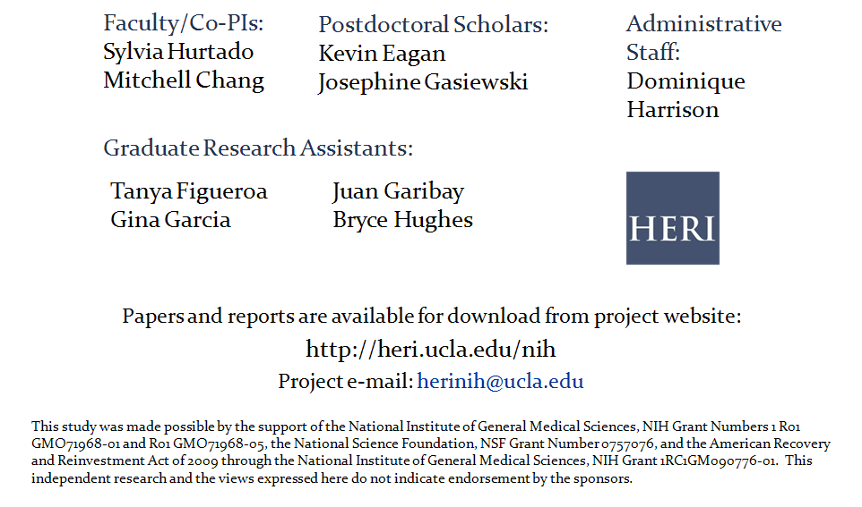
Contact Information

