Slide 1
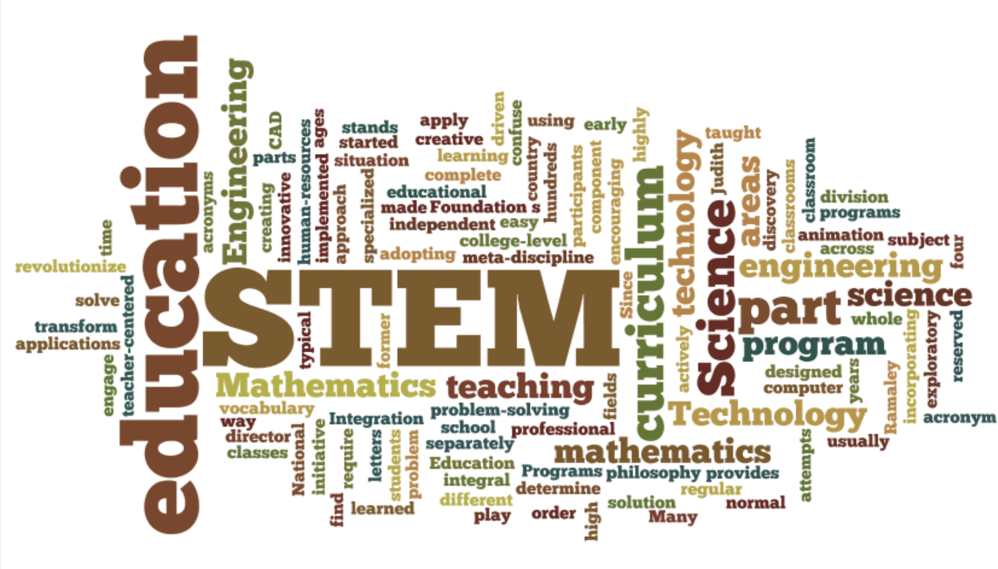
STEM Undergraduate Education: Increasing Diversity & Productivity
Sylvia Hurtado, Professor
UCLA

Slide 2
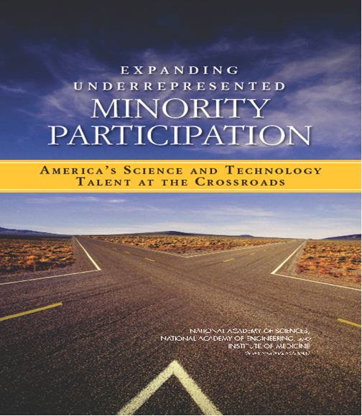
National Consensus Reports
Barriers and Opportunities to
2- and 4-year Undergraduate STEM Degrees: A Pathway Framework
(forthcoming report in 2015)
National Academy of Sciences
National Academy of Engineering

Slide 3
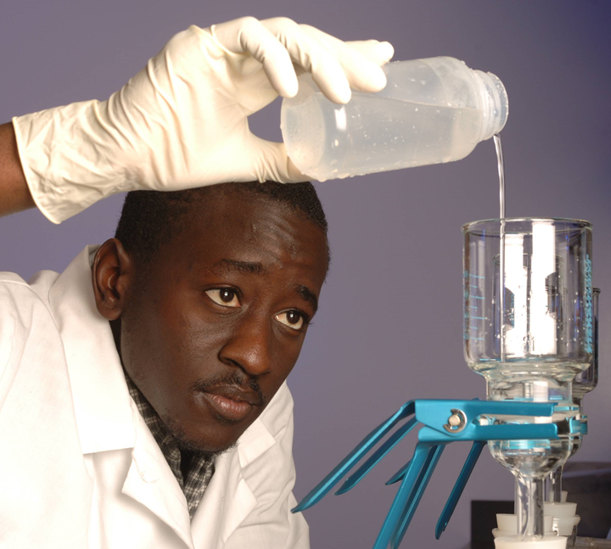
A National Imperative
National Academies (2011) Report Expanding Underrepresented Minority Participation: America’s Science and Technology Talent at the Crossroads
  Most of the growth in the new jobs will require science and technology skills
  “Those groups that are most underrepresented in S&E are also the fastest growing the general population” (National Academies, 2011, p. 3).
  To achieve long-term parity in a diverse workforce, they recommend a near term, reasonable goal of improving institutional efforts to double the number of underrepresented minorities receiving undergraduate STEM degrees.

Slide 4
A National Imperative
2012 President’s Council of Advisors on Science and Technology (PCAST) Report, Engage to Excel: Producing One Million Additional College Graduates With Degrees In Science, Technology, Engineering, And Mathematics
  Increasing STEM degrees from 40% to 50% would, alone, generate three-quarters of the targeted 1 million additional STEM degrees over the next decade
  Retaining more STEM majors is the lowest-cost, fastest policy option to providing the workforce that the nation needs
  Changing productivity levels means changing practices and mindsets from priming the sieve to priming the pump, or talent development

Slide 5
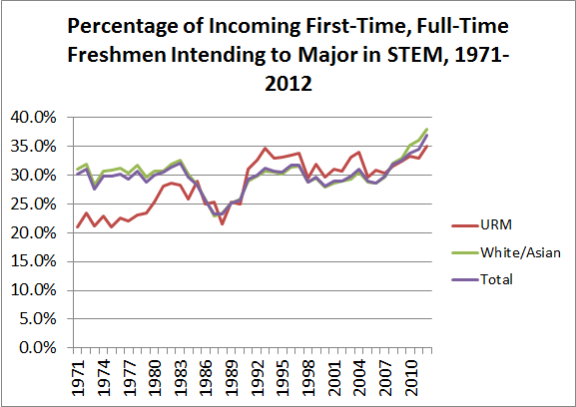

Slide 6
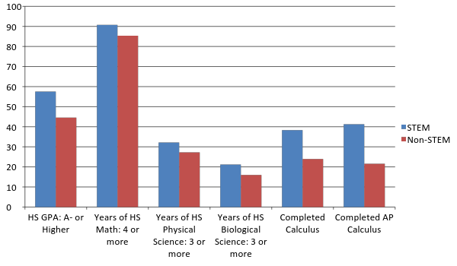
Pre-College Preparation among STEM and non-STEM Aspirants, Fall 2012

Slide 7
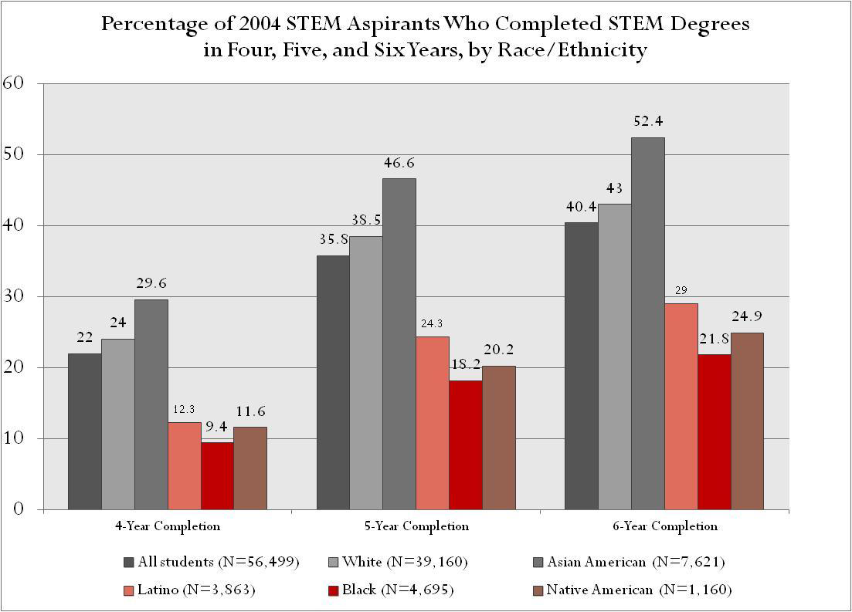
Notes:
Data Source: 2004 Freshman Survey, 2010-11 National Student Clearinghouse; HERI, UCLA

Slide 8
Factors in Managing Academic Success in the 1st Year
Source: Predicting Transition and Adjustment, Research in Higher Education (2007)
* Indicates effect is stronger for URM STEM students
NEGATIVE EFFECTS
Interfering family responsibilities
Concern about financing college*
Perceptions of a competitive environment *
Perceptions of a hostile racial climate*
Institutional selectivity
Academic advice from a freshman peer *
POSITIVE EFFECTS
Self-rated ability to manage time
Best guess they will communicate with faculty
High proportion of degrees in science
Worked with an academic advisor to select courses
Academic advice from a junior/senior and major/preprof clubs*
Change in ability to conduct research
Notes:
The issue of context is highlighted by the findings in terms of external push and pull factors, ability to finance college and campus climate of competition and racial hostility perceived by students. In terms of institutional context, the more selective institutions contribute to ALL students difficulty in managing academic success in the first year of college. It is interesting to note that students that rely on other freshman for academic advice end up with a lower sense of academic success than students who sought upper class advise or participation on peer groups formed around their major/career aspiration. Perceptions of ability to manage time, communicate with professors, and working with advisors to select courses helped students feel like they successfully navigated the academic environment. Also strong was having a peer culture of science, seeing the relevance of coursework to everyday life, and changes in their ability to conduct research were positive factors for students.

Slide 9
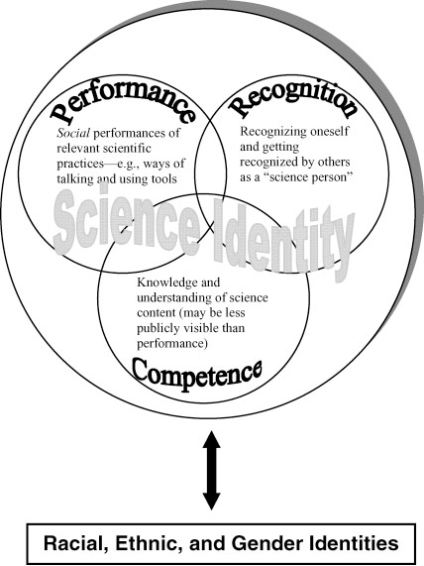
Source: Carlone & Johnson. (2007). Journal of Research in Science Teaching, 44 (8).
Notes:
Some of you may be familiar with this science identity model derived from research on undergraduate women of color. It is useful in emphasizing a couple of key points. First, science identity is not defined by the GPA, though it informs these constructs, the model provides a broader way of measuring performance, and understanding the value of recognition by others who see students’ potential in becoming a scientist.
A second important point, is that one’s social identity with particular communities is ever present—meaning these other identities are not left behind but become integrated in becoming a science person. Third, college is a particularly important time for the formation of all types of identities and much has to do with the peers and environments (social contexts) in which students find themselves. We wanted to expand our understanding of social contexts for students in science.

Slide 10
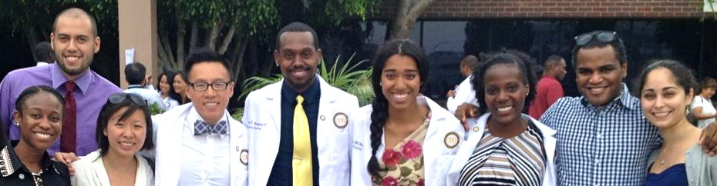
Findings: Becoming a Scientist
Recognition
  I had a good experience with my PIs [principal investigators] just because they made me feel like…as an undergrad, you kind of feel like on the bottom of the food chain and they kind of believe in you and say, “Yes, you can do this. I’m giving you this project to do and I know you can do it.” So it kind of builds your confidence and just them believing in you makes you feel like you can actually complete the project because you can. (female)

Slide 11
Expanding Theory With Findings: Context Matters
Source: Focus groups of students in programs reported in Diversifying Science, Research in Higher Education (2009)
Competence
Students talk about science
differently in the classroom, in a
professor’s project, or in a
structured research program
(peers, dedicated faculty)
Recognition
Institutional ethos – “We do science here”
Peer culture
Proximal contexts, faculty belief in students’ potential and determination to succeed
Emergent Results
Knowledge/content is to be mastered (memorized) versus knowledge can be discovered and “owned”
Science is competitive, getting right answers vs. collaborative using both challenge and support
More ways of demonstrating competence
Failure in scientific work is OK Rethink and try again until one succeeds
Validation from faculty and peers
Notes:
We have been studying interventions, particularly student participation in undergraduate research (NIGMS investment) so we spoke to students in these programs on five campuses and among the key findings that modified the theory is that context matters and shapes how students become scientists. We have to give students opportunities to experience the empowering, collaborative, forgiving of failure side of science, instead of simply the disempowering, competitive side focused on getting the right answers. Challenge and support takes students to their “learning edges.”

Slide 12


Retention in STEM: First Year
Source: Three different studies, one student dissertation, listed on project website
URM students with a high level of science identity were 4 times more likely to persist than their counterparts who reported moderate level of identification, 8 times more likely than those with the weakest level of identification
However, those with high science identification and hostile racial climate perceptions were among students less likely to persist in the first year
Black students were 4 times more likely to participate in first year research if a structured program existed on a campus
Selective institutions negatively affect persistence in the first year of college
Women of color persisted in STEM to the fourth year if they joined student organizations, discussed course content outside of class, and participated in undergraduate research programs

Slide 13

Changing Mindsets: Who has talent
Every single one of those students in my [introductory biology] classroom had the potential to succeed, I absolutely believe that’s the case and some had farther to go to succeed than other students in the class…[And] whether a student gets through the class or not… those all get accumulated into institutional success, which is frequently measured by retention
rates.
– Female Biological Science Professor
and Dean of Science
Notes:
Anyone has the potential for talent development:
Everyone has potential for anything. There is quote of Joseph Campbell that “Inside each there is the all.” ... In practice well that makes my job easy in some sense… I don’t believe that there any broken students... [So] to achieve within a math classroom. I recognize that it occurs in different ways, that the student can experience gains in learning or routines or developments so that even though they don’t pass the class that they can still grow and they could have gotten smarter... – Dr. Jeremiah Hower, Instructor in Math and Statistical Science, FIU

Slide 14

Changing Behavior: Teaching Practices Focused on Improved Learning
I wasn’t happy with the learning gains [my students] were making. I knew some people were getting it but I wanted almost everybody to get it. I think it was only after I started going to [the discipline-based education research meetings] that I started reading [about undergraduate STEM education reform and research] and started going to [the Center for the Advancement of Teaching] workshops. I started moving further and further away from lecture … my golden chance came when I got the HHMI Fellowship and [the dept. gave me] my own learning assistants. At that point I said, ‘okay this is my opportunity to show that if the learning assistants are there in class every single day, it can mean a huge difference.’ And it did.
– Female Chemistry Professor
Notes:
To create a culture of change, intentionality is a must. It is important that the university is intentionally focused on student’s success and making sure that students are progressing and graduating. Faculty must make a real conscious effort to say, “Are we teaching in the right way? Do we have the right instructors or faculty teaching?”

Slide 15
Changing Teaching Culture
Faculty reflect on their teaching techniques:
Focus on learning instead of the volume of information
  Think, ‘What do I want my students to be able to do after they take this course?’ instead of, ‘What amount of info can I cram into them?’ - Female Biology professor
Focus on the relevance of coursework to problems that matter (e.g. improving the health of minority communities)
Collaborate across departments so that the curriculum in foundational courses supports student progress (e.g. what are the courses that affect the progress of BBS students or URM students in particular?)
Notes:
*Adjusting to academic demands - One of the biggest [obstacles students face] is just that pure volume of information [they need to learn.]... It’s that transition from high school to college and even students who’ve taken AP [classes], [college work] it’s just on a completely different scale and pace [of what they are used to.] And so I think that students being ready to handle that [is an issue],... the change in the quantity of information and the expectations. ̶ Dr. Michael Heithaus, Biology Professor and Dean of College of Arts and Sciences , FIU
**Culturally responsive interactions
I would used myself as an example so that's the value of having minority faculty that can help interface with some of these questions. For me as a Navaho, we don't go near any archaeology. That's very bad, because they’re ancestors, so we stay away from that. Yet, my graduate degree required me to take archaeology courses and anthropology courses. So, I had to figure out for myself and I did in consultation with my grandmother. How do I figure out, how do I successfully achieve my degree and yet not break any of the rules that are laid out there. So, I think I did that successfully and my professors knew and they never pushed me, and I was not required to go in and participate in a dig or anything like that. There were other ways that could gain that knowledge, so I would do the same for a student and try to, let them know I value and I understand exactly what you're saying. This goes for any student from any culture. We do all feel that way. It’s just that I have that personal example, so we just try and make them comfortable and then try and come up with what is the objective we're trying to get out here... I know that some cultures are not allowed to view clouds in great detail..Well it’s really understanding water vapor in the atmosphere and condensations. So, can we do that in another way? - Dr. Nancy Johnson Elder, Associate Dean of Academic Affairs & Professor in School of Earth Sciences Environmental Sustainability, NAU
***Some faculty are starting to collaborate across departments to make changes to the curriculum in foundational courses:
We decided to take some of the problems that involve logs and stuff from general chemistry and put them into the algebra curriculum so that students will see that there and then when we show that to the students, we can refer back to it saying “Hey, remember you did this algebra”. So, I’m guessing it’s because of things like that [that this campus is successful in graduating high numbers of URM in the sciences]. – Dr. Uma Swamy, Senior Lecturer in General Chemistry at FIU

Slide 16
Changing Faculty-Student Interactions
An ethic of care means being accessible, responsive, and intrusive advising:
  We have this expected high touch component. I would describe it as reaching out to students. Especially students who have fallen behind and who have kind of withdrawn from the course – for whom that extra connective experience will make a difference in their performance and in their learning. So it is usually it is similar to calling and texting [the student]. Some [faculty] do it different ways. Like one of my colleagues she has a certain time every week like an hour or two, and she just does it then. For others, it is not as regular or as needed.. I don’t think many other departments are [doing this]... We are kind of trying to institutionalize this. [Students’ response to this high touch approach is] usually very positive... I text, for example, which I switched to as my primary mode of communication [with students] for nothing else then because they respond. They are very thankful, they are very grateful. [Just] yesterday I connected [with a student] and he said I was the first professor in his post-secondary life to ever contact him.
  – Male Instructor in Math and Statistical Science, HSI
Notes:
Interestingly, having a high touch acts as a natural feedback loop:
I have in a class for example asked questions, “How are you doing?” “Do you think you are learning?” “Where are you struggling?” These sorts of things, I have sensed that students really appreciate it... [And I ask] the whole class [these] questions. It is a writing assignment and they turned it in. It creates this feedback loop… [At first] this wasn’t even in my radar that this would be useful, that this would be something that I should do but to my evolution [as a math teacher] it is kind of becoming normative practice. – Dr. Jeremiah Hower, Instructor in Math and Statistical Science, FIU

Slide 17
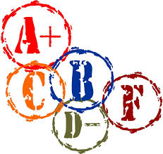
Changing Mindsets: Grading Practices
Dismantling the bell curve mentality in higher education and shifting to a student-centered approach to learning:
  One of the biggest challenges…what I saw early in my career here is people said that my job was to ‘profess’ and students would learn or they wouldn’t. And it’s breaking that mindset—that we are here to facilitate learning, not just teach… Because if you think about a bell curve, it makes teaching improvement irrelevant because the same proportion of students are going to fail or get a C, no matter what you do... So, if you’re really measuring what students learn and have a sense of what they should know at the end of a class – there should be grades actually improving through time… those are things that remain challenges in some pockets here… it’s so ingrained in, “This is how we grade” or “This is what we do”.
  – Biology Professor and Dean of Sciences
Notes:
Other faculty at other institutions also saw the benefits of moving away from GPA as the predominant indicator of talent. At another HSI in the west, a couple of faculty members wanted to create scholarships and undergraduate research programs only for students who were in the GPA range of 2.3 to 3.0 GPA because there were noticing that higher GPA students were getting all of the awards (aka having disproportionate access to the opportunity structure.) These faculty thought resources could be better used if they were a little bit more spread out, to serve more students. They realize that just because a student doesn’t have a high GPA doesn’t mean she is not capable of doing really, really excellent research. And it could be just that she thinks differently and so she doesn’t take tests as well.

Slide 18
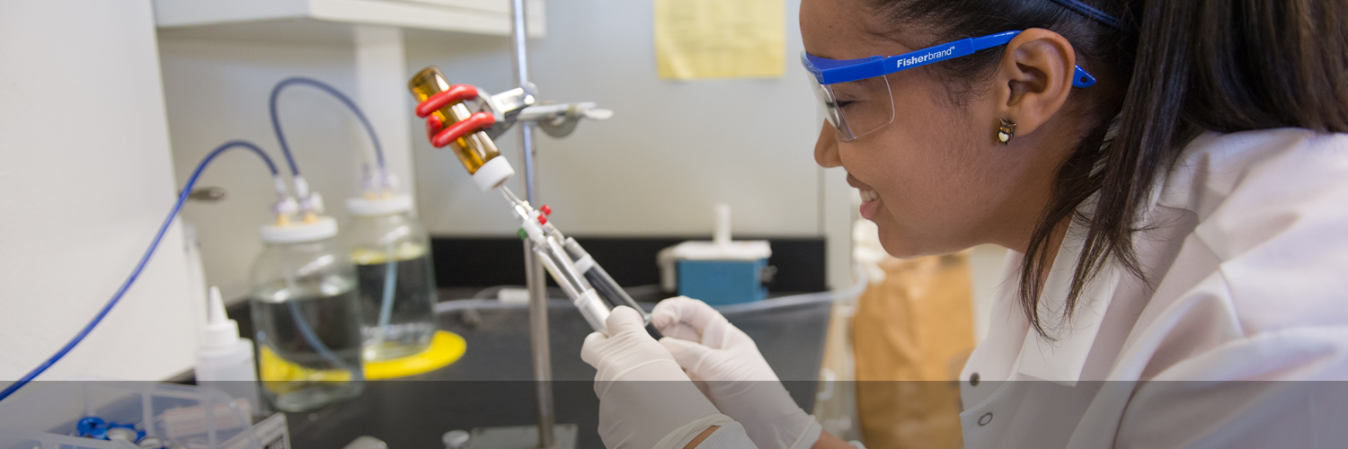
Long Term Impact of Practices
(Quasi-experimental, Longitudinal Study)
Supplemental instruction as a way to establish a community of practice
  Strengthens students’ STEM identity; particularly beneficial for URM STEM identity development
  Boosts grades in introductory STEM courses
  Increases likelihood to plan to enroll in STEM graduate programs
Faculty Mentorship and Support
  Improved performance in STEM courses
  Mentorship even more impactful for URM students’ STEM identity development
  Increases students’ intentions to enroll in graduate school
  Benefits of mentorship extend even after accounting for the types of students likely to receive or seek out mentorship
Notes:
One of the findings from our work shows that students who participate in one aspect of the opportunity structure are also more likely to participate in other opportunities. The fact that the advantages and benefits associated with the activities in the opportunity structure accrue (Hurtado, Eagan, Cabrera, Lin, Park, & Lopez, 2008), underscores the need for early student access to and participation in these experiences. Further, although it is ultimately up to individual students to decide to become involved in those activities within the opportunity structure, it is the institution’s responsibility to first create campuses that “are ripe with opportunities for students to be engaged” (Wolf-Wendel et al., 2009, p. 425) and to actively and aggressively encourage students from vulnerable backgrounds to participate.

Slide 19

Long Term Impact of Practices
(Quasi-experimental, Longitudinal Study)
UNDERGRADUATE RESEARCH PROGRAMS
  Increases students’ confidence and skills as a researcher
  Significantly increases student intentions to enroll in graduate school and pursue a STEM career. Has added benefit for URMs with respect to GPA
MAJOR RELATED CLUBS
  Provides skills transferrable to the job market
  Participating URM students have a continued interest in a STEM career

Slide 20
Effect of Research Participation on STEM Graduate/Professional School Enrollment
(controlling for propensity to participate in research)
 | Change in probability
All students: Structured program | 0.09
All students: Research with faculty | 0.14
All students: Any research | 0.14
URM students: Structured program | 0.15
URM students: Research with faculty | 0.14
URM students: Any research | 0.17

Slide 21

Conclusion
In order to produce 1 million more STEM degrees, we have to address diversity and equity in attainments and improve access to STEM careers
Contexts Matter!
Selective institutions can improve productivity. They promote degree completion and graduate school aspirations, but students are not more likely to complete in STEM degrees. More work is now occurring in changing classroom practices to actively engage students and be more inclusive.

Slide 22
Conclusion
Supportive Environments Work!
  Having an undergraduate research program has an effect on retaining minority students in STEM (and quicker degree completion)
Pre-med Phenomenon
  Students who are pre-med majors are more likely to complete in STEM, but less likely at selective institutions; high % of pre-meds causes students to switch from STEM among four year completers—presumably a talented group

Slide 23
Conclusion
Call for evidence-based teaching practices in STEM
  Student centered pedagogy was important to staying in STEM for high-achieving minority students.
  More faculty across universities are “flipping classrooms”, introducing learning assistants, and studying the effect of these innovations.
New initiatives by associations and foundations indicate great interest in “demonstration campuses” that can make transformations to increase productivity of STEM degrees.

Slide 24

Resources
Research
For the latest papers, presentations, and findings please visit heri.ucla.edu/nih
Practice
Transformations: Approaches to College Science Teaching (Allen & Tanner, 2007)
Attend
Summer STEM Institute, UCLA for research and practices in STEM

Slide 25
Contact Information
Faculty/Co-PIs:
Sylvia Hurtado
Kevin Eagan
Postdoctoral Scholar:
Tanya Figueroa
Administrative Staff:
Dominique Harrison
Graduate Research Assistants:
Ashlee Wilkins
Damani White-Lewis
Krystle Cobian
Papers and reports are available for download from project website:
http://heri.ucla.edu/nih
Project e-mail: herinih@ucla.edu
This study was made possible by the support of the National Institute of General Medical Sciences, NIH Grant Numbers 1 R01 GMO71968-01 and R01 GMO71968-05, the National Science Foundation, NSF Grant Number 0757076, and the American Recovery and Reinvestment Act of 2009 through the National Institute of General Medical Sciences, NIH Grant 1RC1GM090776-01. This independent research and the views expressed here do not indicate endorsement by the sponsors.

