Slide 1
Understanding the STEM Faculty approaches to Student Talent Development
Damani White-Lewis, Tanya Figueroa, Sylvia Hurtado, Kevin Eagan
Association for the Study of Higher Education
November 2016 | Columbus, Ohio

Slide 2
Problem
National goal to broaden participation in STEM disciplines
Opportunity structure
    Supplemental instruction, internships, unstructured research
Unequal levels of participation and exposure to co-curricular activities that facilitate degree completion
    Because many of these activities operate through faculty, their conceptualization of who has scientific talent matters within the classroom

Slide 3

Talent Development in the Classroom
  Traditional Excellence in Higher Education
  Astin’s Critique: “True excellence lies in an institution’s “ability to affect its students and faculty favorably, to enhance their intellectual and scholarly development, and to make a positive difference in their lives.”
  Traditional Excellence in STEM Classrooms
Notes:
In order to form a basis by which we can understand student talent development operates in the classroom, we consulted the literature on the original architect of the
EXPLAINS: HISTORICALLY, educational excellence in higher education has been synonymous with selecting high achieving students who enter college already positioned to perform well academically, SO FOCUSING ON THE “I” AND NOT THE “E” OR “O”
(2) To challenge this historical definition of educational excellence, <READ QUOTE> From this perspective, the most excellent institutions are those with the greatest impact on students and those that add the most value to their developing skills set.
PUT forward IEO, had a successful career, yadda yadda
(1) STEM disciplines have been critiqued similarly, using practices such as weeding out and grading on a curve to select high achieving students who enter college already positioned to perform well (That should sound familiar)
(2) Thus, the most excellent faculty in STEM should be those who have a great impact on students and develop their talents through pedagogical and interactional practices
STUDENT TALENT DEVELOPMENT APPROACH TO TEACHING

Slide 4
Research Question
  What are the individual and institutional level predictors of faculty approaches toward student talent development to teaching?

Slide 5
Guiding Literature
Demographic & Professional Characteristics
Research & Teaching
Student Talent Development Approach to Teaching
Classroom Approaches
Institutional Characteristics & Climate

Slide 6
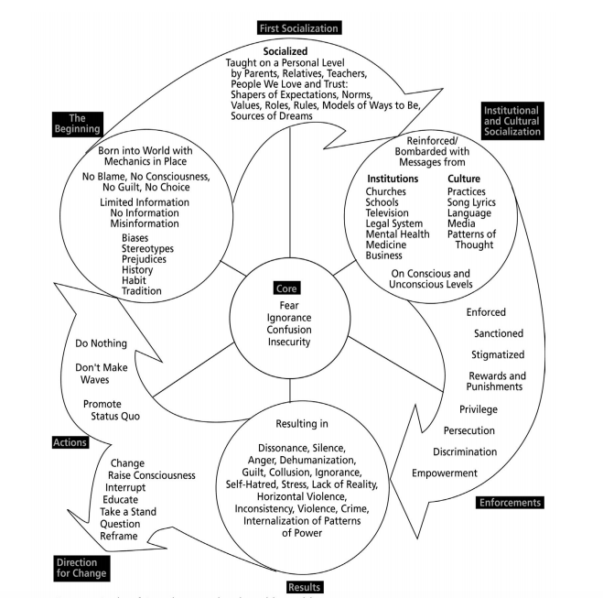
Conceptual Framework
Harro’s (2000) Cycle of Socialization
Stage 1: Social Identity
Stage 2: School & Business
Stage 3: Resultant form of socialization
Feeding back into the cycle of oppression or bends toward change

Slide 7
Methods
Data Sources & Sample
  2013-2014 HERI Faculty Survey
  n=5,465 STEM Faculty
  254 Institutions
  Gender: 44.3% Female, 55.7% Male
  Race: 14.6% Faculty of Color
  Rank: 35.1% Full, 26.6% Associate, 25.5% Assistant, 5% Instructor, 7.9% Lecturer
  Discipline: 15.6% Engineering & Computer Science, 25.2% Life Sciences, 23.8% Health Sciences, 32% Physical Sciences

Slide 8
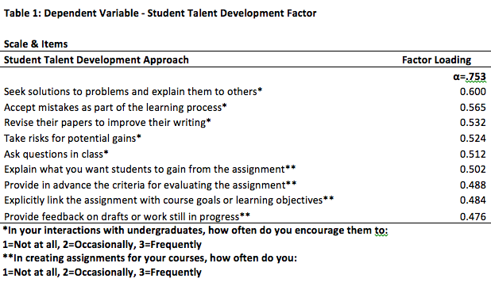
Variables
Dependent Variable

Slide 9
Variables
Independent Variable
  Block 1: Demographic Characteristics
  Block 2: Faculty Characteristics
  Block 3: Research Activities
  Block 4: Research Activities with Undergraduate Students
  Block 5: Teaching Activities
  Block 6: Professional Development
  Block 7: Classroom Practices
  Block 8: Institutional Climate
  Block 9: Institutional Characteristics (Level 2 Variables)

Slide 10
Analyses
  Missing Data: Expectation Maximization (EM) algorithm
  Multicollinearity
  Factor Analysis
  Merging IPEDS Data for 2nd level analysis
  Hierarchical Linear Modeling (HLM)
  - Nested, multi-level data
  - Model a single continuous outcome variable with multiple independent variables, providing strength and direction of associations
  - Must vary between faculty at an institution and between

Slide 11
HLM Results
 | T-ratio | b | Sig.
Block 1: Demographic Characteristics
Sex (Female = 2, Male = 1) | 0.713 | .15
Faculty of Color (No = 1, Yes = 2) | 0.270 | .10
Block 2: Faculty Characteristics
Instructor (Ref: Full Professors) | 3.704 | 2.10 | ***
Lecturer (Ref: Full Professor) | 3.116 | 1.83 | **
Life Sciences (Ref: Physical Sciences) | -5.807 | -1.80 | ***
Engineering (Ref: Physical Sciences) | -3.024 | -1.20 | **
Health Sciences (Ref: Physical Sciences | -5.769 | -2.13 | ***
Block 3: Research Activities
Scholarly Activity | -1.671 | -.13
Importance: Research | -1.041 | -.03
Hours per week: Research & Scholarly Writing | 1.177 | .10
Block 4: Research Activities with Undergraduate Students
Research with undergraduate students | 4.040 | .07 | ***

Slide 12
HLM Results
 | t-ratio | b | Sig.
Block 5: Teaching Activities
Taught an honors course | 2.345 | .67 | *
Taught an interdisciplinary course | 0.353 | .08
Taught a seminar for first-year students | 2.554 | .68 | *
Hours per week: Preparing for teaching | 6.057 | .43 | ***
Hours per week: Advising and counseling students | 3.144 | .39 | **
Hours per week: Committee work and meetings | -0.202 | -.03 | ***
Mentor undergraduate students | 12.531 | 3.60 | ***
Importance: Teaching | 3.915 | 1.40 | ***
Importance: Service | -1.393 | -.22
Block 6: Professional Development
Paid workshops outside of the institution focused on teaching | 0.543 | .14
Incentives to develop new courses | -1.007 | -.36
Incentives to integrate new technology into your classroom | 2.285 | .57 | *

Slide 13
HLM Results
 | t-ratio | b | Sig.
Block 7: Teaching Practices
Extensive Lecturing | -0.616 | -.09
Using real-life problems | 2.747 | .40 | **
Using student inquiry to drive learning | 7.760 | 1.28 | ***
“Learn before lecture” using multimedia tools (e.g. flipping the classroom) | 3.935 | .47 | ***
Supplemental instruction that is outside of the class and office hours | 1.968 | .25 | *
Grading on a curve | 0.828 | .08
Student Centered Pedagogy | 8.925 | .17 | ***
Block 8: Institutional Climate
Faculty here are strongly interested in the academic problems of undergraduate students | 1.957 | .36 | *
Block 9: Institutional Characteristics (Level 2)
Control (Public = 1 vs. Private = 2) | -3.017 | -1.02 | **
Research (Ref: Masters) | -2.011 | -.88 | *
Notes:
Student Centered Pedagogy

Slide 14
Discussion
  Importance of mentoring undergraduate students
  Differences by professional characteristics
  Juxtaposition of Research: individual productivity & research with undergraduate students
  Teaching practices are strongly associated with a student talent development approach!
  Institutional characteristics: Control and Type
.

Slide 15

Conclusion & Implications
A variety of different contexts are associated with faculty’s expanded view of scientific talent
Need to recognize the diverse and understudied contributions of instructors and lecturers
Certain classroom practices demonstrate a commitment to adding value
Role of professional development
    Questions?

Slide 16
Contact Us
Faculty/Co-PIs:
Sylvia Hurtado
Kevin Eagan
Postdoctoral Scholar:
Tanya Figueroa
Administrative Staff:
Dominique Harrison
Graduate Research Assistants:
Ashlee Wilkins
Tracy Teel
Ana Gomez
Damani White-Lewis
Krystle Cobian
Papers and reports are available for download from project website:
http://heri.ucla.edu/nih
Project e-mail: herinih@ucla.edu

