Slide 1
Making Future Scientists:
Campuses’ Efficiency in STEM Degree Production
Kevin Eagan, Sylvia Hurtado, Tanya Figueroa, & Bryce Hughes, UCLA
Association for Institutional Research Annual Forum
Orlando, FL
May 29, 2014

Slide 2
Introduction
Colleges and universities are increasingly held to accountability standards tying public funding to metrics like graduation rates
Unadjusted production metrics fail to account for various forms of capital available to institutions
Without context, policymakers and institutional leaders have an incomplete picture of the improvements that need to be made

Slide 3
Purpose
To determine how efficiently colleges and universities produce STEM degrees and to identify contextual factors that influence efficiency
To utilize an econometric method for estimating efficiency that situates efficiency within the context of an institution’s mission, resources, and available capital

Slide 4
Productivity Theory
Production is the process by which a set of inputs is converted into a firm’s output
A production frontier is the maximum amount of output a firm can produce given its existing capital and technology
Inefficiency is the difference between actual output and potential output at the production frontier

Slide 5
Productivity Theory
When applied to higher education, key differences between firms and colleges arise:
  Profit maximization is not applicable as most colleges are non-profit
  Colleges and universities produce multiple outputs (research, teaching, and service)
  Productivity theory is limited in accounting for democratic outcomes of higher education beyond conferment of degrees

Slide 6
Efficiency of Higher Education
American universities average around 80% efficiency in overall degree production
European and Australian studies have also found averages above 70%
Private universities tend to be more efficient than public
Number of faculty, undergraduates, and graduate students have all been demonstrated to influence university efficiency
Environmental and contextual factors also influence efficiency in significant ways

Slide 7
Data and Sample
IPEDS data from 2002, 2004, 2006, 2008, 2010, and 2012
All four-year non-profit colleges and universities that produced at least 10 STEM bachelor’s degrees in each of these years
Pulled data from adjudicated Delta Cost Project

Slide 8
Variables – Production Function
Dependent Variable
  Total STEM bachelor’s degrees produced each year
  Total degrees produced within each STEM discipline per year
Independent Variables
  Human capital: Number of STEM undergraduates, number of all FTE undergraduates, number of FTE graduates
  Labor: FTE faculty
  Financial capital: Operating expenditures per FTE student

Slide 9
Variables – Efficiency Analysis
Minority-serving status (HSI, HBCU)
Control
Selectivity
Average faculty salary
Urbanicity
Proportion of part-time faculty
Proportion of STEM undergraduates

Slide 10
Analyses
Production function
  Econometric technique: stochastic frontier analysis
  Basic assumption: labor and capital contribute to output production
  Can be a fairer comparison of institutional productivity
  Compares institutions’ actual production to their potential production based upon peer output
  Ability to account for random effects – production models might differ across institutional types
  More sensitive to measurement error

Slide 11
Analyses
Understanding efficiency
  Descriptive statistics
  OLS regression

Slide 12
Limitations
IPEDS data are limited
Econometric techniques ignore many other contextual aspects of the college environment
Multiproduct nature of higher education institutions

Slide 13
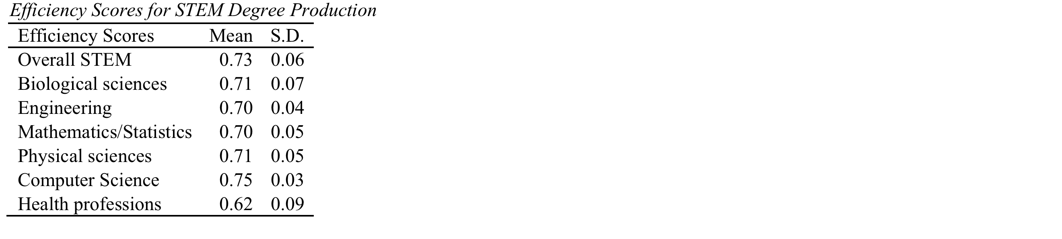
Findings

Slide 14
Predictors of STEM Degree Production
STEM enrollment (+)
Expenditures per FTE student (NS)
FTE faculty (+)
Undergraduate FTE (-)
Graduate FTE (-)

Slide 15
Predictors of STEM Efficiency
Public (+)
HBCU (+)
Selectivity (+)
Proportion of part-time faculty (-)
Proportion of undergraduates in STEM (-)
Explained variance: 32%

Slide 16
Discussion
Role of faculty: more FTE faculty contrasted with part-time faculty
Non-significance of expenditures per FTE
Positive effect of selectivity even after comparing peer institutions’ STEM degree productivity
Positive roles of HBCUs

Slide 17
Next Steps
Tie climate measures to efficiency estimates
Consider alternative contextual measures:
  STEM-specific funding
  STEM-specific plant and equipment
Analyze data by gender and race/ethnicity
Identify undergraduate institutions that are high producers of eventual STEM Ph.D. earners

