Slide 1

Improving Degree Attainment Rates:
Lessons from Hispanic Serving Institutions
Ana K. Gomez, Krystle Palma Cobian, Sylvia Hurtado
American Educational Research Association
April 2018| New York, NY

Slide 2
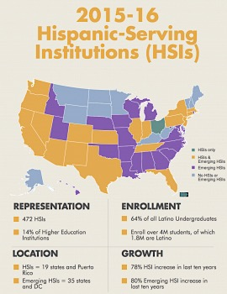
Overview
Background
Framework
Methods
Results
Implications

Slide 3
Background and Purpose
HSIs enroll…
A greater share of Black students in the U.S. than Historically Black Colleges and Universities (HBCUs) (16% compared to 10%)
Higher share of Native American students than Tribal Colleges and Universities (TCUs) (14% compared to 11%)
(Hurtado & Alvarado, 2015)
Purpose
Cross-case analysis of 11 institutions that are exemplary in graduating URM students with STEM degrees to identify strategies unique for HSIs
Notes:
The majority of Latinx students enrolled at four-year colleges and universities (62.3%), are concentrated in Hispanic Serving Institutions (HSIs)
HSIs: federally designated colleges and universities that enroll at least 25% Latinx students (Núñez, Hurtado, & Galdeano, 2015).
In addition to serving increasingly large shares of Latinx students, HSIs also serve students who have historically had less access to rigorous high school preparation and higher education, enrolling a greater proportion of students from low-income, first-generation, and/or racial/ethnic backgrounds (Núñez et al., 2015).
Considering the important role that HSIs play in creating access to postsecondary education and STEM bachelor’s degrees for underrepresented groups, these are important institutional contexts for further inquiry that can result in lessons for other institutions.

Slide 4
Framework
HSI Organizational ID
(Garcia, 2013)
regionally focused
committed to the surrounding community
dedicated to access
committed to serving a diverse population
Typology of Institutional Diversity
Núñez, Crisp, and Elizondo (2016)
Urban Enclave CC
Rural Dispersed CC
Big Systems Four-Year
Small Communities Four-Year
Puerto Rican Institution
Health Science School
HSI Typology of Organizational ID
Garcia (2018)
Latinx-enrolling
Latinx-producing
Latinx-enhancing
Latinx-serving
Notes:
Núñez et al.’s (2016) typology identifies six clusters of HSIs: (1) Urban Enclave Community Colleges, (2) Rural Dispersed Community Colleges, (3) Big Systems Four-Year Institutions, (4) Small Communities Four-Year Institutions, (5) Puerto Rican Institutions, and (6) Health Science Schools.
Using this typology, three of the HSIs in this study can be categorized under Cluster 3: Big Systems Four-Years, which encompasses institutions that typically belong to state public institution systems, have large student enrollments, offer bachelor’s degrees or higher, are public, are overrepresented in cities, contain an overrepresentation of full-time faculty, female students, and students receiving Pell Grant assistance, and have the lowest average graduation rates (Núñez et al., 2016).
The fourth HSI in this study fits under Cluster 4: Small Communities Four-Year, which comprises private institutions that offer bachelor’s degrees or higher, are often liberal arts colleges or religiously affiliated institutions, are typically located in urban and suburban areas, emphasize graduate education, have higher tuition and fees, receive little government support, and have the highest graduation rates

Slide 5
Methods

Slide 6
Institutional Pseudonym | Control | MSI Status | Classification | STEM Bachelor’s Degree Efficiency Score
Southeast State University | Public | HSI | Doctoral Universities: Highest Research Activity | .82 Latinx .53 Black .35 American Indian
West Coast State University | Public | HSI | Master's Colleges & Universities: Larger Programs | .83 Latinx .37 American Indian .27 Black
East Coast State University | Public | HSI | Doctoral Universities: Higher Research Activity | .81 All STEM
Southern Private University | Private | HSI | Master's Colleges & Universities: Larger Programs | .65 Latinx .35 American Indian .12 Black
Central Plains University | Public | N/A** | Doctoral Universities: Higher Research Activity | .96 American Indian .44 Latinx .35 Black
Northern Mountain University | Public | N/A** | Doctoral Universities: Higher Research Activity | .94 American Indian .75 Latinx .25 Black
Atlantic Southern University | Public | HBCU | Master's Colleges & Universities: Medium Programs | .89 American Indian .84 Black .52 Latinx
Mid-Atlantic University | Private | HBCU | Doctoral Universities: Higher Research Activity | .81 All STEM
Western Private College | Private | N/A | Baccalaureate Colleges: Arts & Sciences Focus | .73 All STEM
University of the Southeast | Public | N/A | Doctoral Universities: Highest Research Activity | .79 All STEM
Midwest State University | Public | N/A | Doctoral Universities: Highest Research Activity | .75 All STEM
STEM Exemplar Institutions Visited
Notes:
15-25 STEM faculty, program directors, and administrators interviewed at each campus

Slide 7
Methods (Cont.)
Stochastic Frontier Analysis → efficiency scores → Selection of 11 diverse institutions with high efficiency scores → web scraping → 15-25 interviews per site visit (faculty, senior administrators, STEM program directors → wrote institutional reports → Coded transcripts: open coding, axial coding, team inter-rater reliability 85%→ Cross-case analysis: constant comparison using matrices, institutional reports, codes, team discussions until themes from HSIs became salient
HSI Name | Southeast State University | East Coast State University | West Coast State University | Southern Private University
Carnegie Classification | Public R1 | Public R2 | Public Master’s | Private Master’s
Undergraduate Enrollment | 41,038 | 8,170 | 22,157 | 4,620
Latinx Enrollment % | 67% | 27% | 42% | 41%
Admittance Rate % | 50% | 65% | 39% | 77%
Institutional Diversity Typology | Big Systems Four-Year | Big Systems Four-Year | Big Systems Four-Year | Small Communities Four-Year

Slide 8
Results: Typology
Latinx-enrolling
Enrollment
Equitable Outcomes
Organizational Culture
Latinx-SERVING
Southeast State University East Coast State University Southern Private University
Latinx-ENHANCING
West Coast University
Latinx-enhancing
Latinx-producing
Latinx-serving
Notes:
Based on Garcia’s (2018) typology of organizational identities
Latinx-serving: Southeast State University, East Coast State University, Southern Private University
Latinx-enhancing: West Coast University

Slide 9
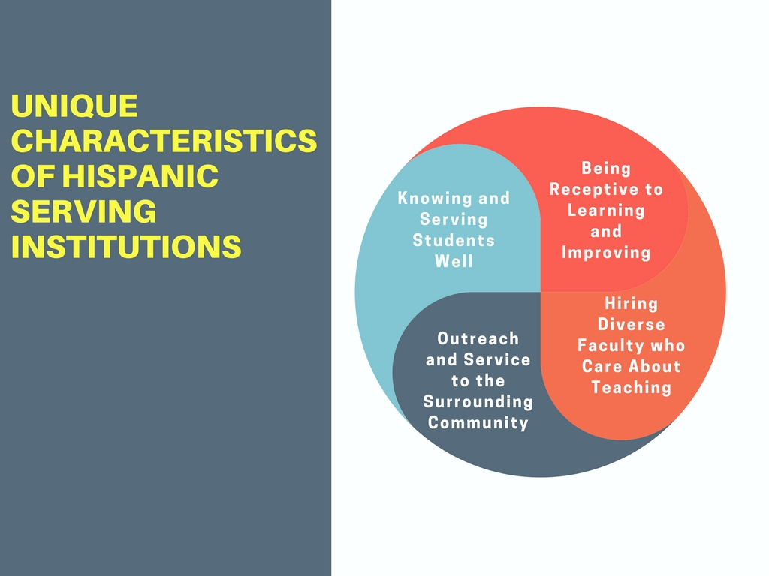
Themes

Slide 10
UNIQUE CHARACTERISTICS
Knowing Students Well
“They care about you as a student, as a person who is also a student. I’ve had teachers tell me that they’ve bought books for students. I often see people put themselves out for students—I think that’s everyone here, in general, for the most part.. The students here, you treat them like your kids.”
Faculty, agriculture department, East Coast State University
Understanding Students and their Backgrounds Through an Anti-deficit lens
Meeting Students Where They Are Academically
Promoting a
“High-touch” Culture

Slide 11
UNIQUE CHARACTERISTICS
Being Receptive to Learning and Improving
“A lotta the innovations have been things that have been happening nationally.”
Faculty, biological sciences, Southern Private University

Slide 12
UNIQUE CHARACTERISTICS
“If you’re a faculty member in Southeast State University you have extensive experience working with underrepresented minorities because that’s our student body. And I would say – I don’t know if it's the majority but certainly approaching a majority of our faculty members are themselves very diverse in terms of their ethnicity or race. And then we have African Americans, Indians, Hispanics, Asians, I mean our faculty is probably almost as diverse as our student body but not quite.”
Program administrator, Southeast State University
Outreach and Service to the Surrounding Community
“We consider ourselves...not being solely in (city), but of (city). That means that our linkages and our partners, and when we’re thinking about building educational experiences, we’re not solely thinking about building them for our graduate or undergraduate students. We’re also looking at enhancing a pipeline of students and opportunities.”
Senior administrator,
East Coast State University
Hiring
Diverse Faculty Who Care
About
Teaching

Slide 13

Strategies Across Institutitons
LEARNING
MATH
ASSISTANTS
University of the Southeast (large PWI)
Western Private University (small PWI)
Southeast State University (large HSI)
West Coast State University (large HSI)
Southern Private University (small HSI)
Southeast State University (large HSI)
Central Plains State University (High NA pop.)
Mid-Atlantic University (HBCU)
Midwest State University (large PWI)
Other reasons for efficiency, I think, are newish models. For example, our use of learning assistants. I don't know if you've heard about that but it is undergraduates who, senior or junior undergraduates, started off in Physics. In fact, it was a PKAL initiative....that's now spread to biology and is spreading to geology. So, we're spreading some efficient practices. So, in for example, a larger lecture, there would be either breakouts or availability of these allies, peers essentially to say, "This is how you succeed in this class." So, that's an efficient use of resources.
Faculty member, biological and physical sciences,
West Coast State University
Math learning centers
ALEKS (adaptive learning software)
Intro course curriculum alignment
Hiring math education faculty
Notes:
It is important to note that the HSIs employed a host of practices that had often been proven elsewhere, adopted, and adapted for their students. We do not include practices that are prominent among institutions nationwide, such as undergraduate research, which is a proven and evidence-based practice.

Slide 14
Conclusion & Lessons Learned
Institutional belief that the success of their students is the success of the institution
Confirms the findings of earlier organizational identity work
Unique ways in which HSI STEM exemplars carry out commitments
knowing and serving students well // being receptive to learning and improving //hiring diverse faculty who care about teaching // outreach and service to the surrounding community
Shows what is possible in the face of resource constraints

Slide 15
Contact Us
Faculty/Co-PIs:
Sylvia Hurtado
Kevin Eagan
Administrative Staff:
Dominique Harrison
Graduate Research Assistants:
Hector Ramos
Ana Gomez
Damani White-Lewis
Krystle Cobian
Papers and reports are available for download from project website:
http://heri.ucla.edu/nih (presentations)

