Slide 1
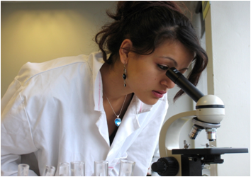


Trajectories of Underrepresented Students in STEM: Findings from Research & Implications for Practice
Tanya Figueroa Gina Garcia
Bryce Hughes Sylvia Hurtado
AACU 2012

Slide 2
Purpose of this Session
Gain an understanding of the unique experiences of students of color in STEM
Identify challenges and opportunities to URM retention and improve the use of “evidence-based” approaches
Discuss best practices for diversifying the STEM postsecondary pipeline and creating more equitable outcomes
Discuss implications for your institution

Slide 3
Overview/History of Project
What do successful STEM pathways look like for underrepresented minority (URM) students?
  URM = African American, Latina/o, and American Indian
Mixed method study
  Longitudinal surveys
  Campus site visits using focus groups, interviews over the last eight years
Notes:
We need purpose of the project
Key findings here too?

Slide 4
Efficacy of URP on intentions to enroll in graduate school
That was key for me was having research experience as an undergrad and somebody to kind of push you to do it. I think that's fundamental. That's how you get interested in graduate school...But yeah, undergrad research is a must. When you present, you're presenting at meetings and you're writing papers and essentially like I was an undergrad, I did a research project for two years--an independent research project that we're publishing now.
(Steven, Native American, graduate ecology major)

Slide 5
Identifying student talent
[I identify talent] by those people who ask good questions in class. By people who are not willing to accept things on face value. Or they will dispute statements that I make. Sometimes they win a few, sometimes they lose a few, sometimes we get a few rained out. I like that.
(Professor Burke, Southwestern Private Research University)

Slide 6
Sample
58,292 Students; 353 Institutions
Sources:
  2004 Freshman Survey (CIRP)
  2010 National Student Clearinghouse
  2007 and 2010 STEM Faculty Surveys (HERI)
  Best Practices Survey
  IPEDS data on institutions
2004 TFS student data linked with 2010 NSC completion data, then matched with STEM faculty data by institution
Method: Hierarchical Generalized Linear Modeling
Notes:
Longitudinal Data on STEM Aspirants
Individual level: 2004 Freshman Survey, CIRP merged with completion data from the National Student Clearinghouse
Sample: 58,292 students across 353 institutions
Faculty Data: 2007 & 2010 HERI Faculty Survey from 659 institutions, with STEM Supplement for over 10,000 STEM faculty
Institutional Data obtained from IPEDS, Aggregates of Faculty, and Aggregates of Peer characteristics from students entering the same institutions in 2004.
Dependent Variable:
STEM completion compared to bachelor’s completion in non-STEM field
Measured six years after freshman year
Note: This analysis does not account for those who dropped out of STEM and did not complete any degree.
Independent variables
Background characteristics
Pre-college preparation and experiences
Aspirations and expectations
Intended major
Aggregate peer effects
Institutional characteristics
Faculty contextual measures
Best practices in STEM
Analysis
National weights
Missing data with multiple imputation
Multinomial HGLM
Limitations
Intended rather than declared major
NSC data – no information on term-to-term major
No college experience measures
Few high school preparation variables
BPS data reported by STEM Deans and Dept. Chairs

Slide 7
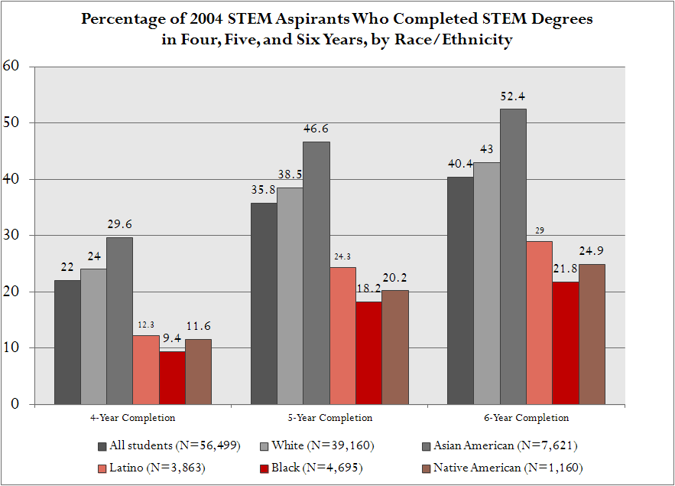
Notes:
Key Findings for Six Year STEM Completion vs. non-STEM Completion (Full Model)
Campus size (-)*
Most differences by race not statistically significant
Exception: Asian/Pacific Islander (+)***
Women (-)*
Women at selective institutions have even lower STEM completion rates **
Parent in STEM (+)***
HS grades (+)***
Enhanced by % faculty using student-centered pedagogy **
SAT composite, years of math and biology (+)***
MD aspirant (+)***
Mitigated by selectivity *** and % of STEM faculty who grade on a curve *
Phd/EdD aspirant (+)***
Law degree aspirant (-)***
Engineering, physical sciences, health technology, nursing, computer science majors (+)***
Pre-pharm, pre-med, pre-dent, pre-vet majors (-)**
Note: * p<0.05, ** p<0.01, *** p<0.001
URM Six Year Completers in STEM
Compared With Non-STEM Completers:
Concentration of premedical undergraduates (-)***
MD aspirants (+)***
MD aspirants at more selective institutions less likely to stay in STEM ***
Law degree aspirants (-)***
Engineering aspirants (+)***
HS GPA (+)***
Enhanced by % faculty using student-centered pedagogy *
SAT Composite (+)***
Females (-)***
Academic self-concept (+)***
No significant differences between URM groups among completers in STEM vs. Non-STEM
Note: * p<0.05, ** p<0.01, *** p<0.001

Slide 8
American Indian Completers
(STEM vs. Non-STEM, 6 years)
Of the 1,160 American Indian STEM starters who successfully complete a degree, 52.2% complete a degree in STEM.
Institutional factors associated with switching out of STEM:
Public control (compared to private)
Liberal arts colleges (compared to master's comprehensive)
HSIs (compared to PWIs)
Normative context associated with STEM completion:
Higher proportions of peers in STEM
Greater proportions of faculty involving undergrads in research
Notes:
Text in red signify correlations that are in the opposite direction as compared to the larger URM model.
Text in purple signify that the variable is NOT significant in larger URM model.
The first fact is using the unweighted data.
When we say "institutional factors," we don't mean to say students should not attend these types of institutions. Rather, we interpret this to mean these types of institutions may want to re-examine their own policies and practices in light of their own data on URM STEM completion to find areas for improvement.
One note on HSIs--this finding is no different from the larger group; however, emerging HSIs, those whose student demographics are reaching the threshold to be considered an HSI are retaining students in STEM, primarily because this group of institutions includes large research universities in areas with growing Latino populations, like California and Texas.
Typically liberal arts colleges do a good job, especially in comparison to master's comprehensive institutions, in terms of STEM completion. Liberal arts colleges tend to be smaller, faculty tend to be more focused on teaching, and student-to-faculty ratio tends to be smaller meaning students have access to more personal and intensive support. In this case, we suspect the negative relationship to be due to the fact that so many of the American Indian students in our sample are at research universities (more than half) and so few are in liberal arts colleges (about 14.5% of our unweighted sample). What is surprising is the fact that no difference between master's comprehensive and research-intensive universities arose in terms of STEM retention (and in fact, crosstabs indicate master's comprehensive institutions do a better job). This may be an area where research intensive universities, especially those with ample opportunities for co-curricular involvement in STEM activities like undergraduate research, could be doing better.

Slide 9
American Indian Completers
(STEM vs. Non-STEM, 6 years)
Students are more likely to finish in STEM when they:
Have a higher high school GPA
Spend more hours per week spent studying in HS
Have a higher Composite SAT
Aspire to be a doctor
Aspire to attain a PhD/EdD
Plan to major in health technology or nursing
Students who are less likely to finish in STEM include:
Women
Those whose mother's level of education is higher
Those with a higher social self-concept
Notes:
Text in red signify correlations that are in the opposite direction as compared to the larger URM model.
Text in purple signify that the variable is NOT significant in larger URM model.
Over half of the American Indian students indicated their mother's level of education was "some college" or less. We think this finding (negative coefficient for mother's level of education) is indicative of a desire for social mobility, that those students whose parents have less education are more likely to encourage their kids to pursue a STEM-related degree. American Indian students whose mother's education level is "high school degree" or less are markedly more likely to complete in STEM.
American Indian students also express a strong interest in health-related careers as many come from communities with strong communal values. In other words, students pursue health-related careers as a way to return and assist in improving the health of their home communities. They pick majors that will allow them to give back after they graduate.

Slide 10
Black Completers
(STEM vs. Non-STEM, 6 years)
Of the 4,923 Black STEM starters who successfully complete a degree, 51.8% complete a degree in STEM.
Institutional factors associated with switching out of STEM:
Having a higher percentage of pre-med students in the student body
Larger institutions
Offering undergraduate research opportunities (without accounting for actual student participation)
Students are less likely to finish in STEM when they:
Are a Native English speaker
Have a higher social self-concept
Notes:
Text in red signify correlations that are in the opposite direction as compared to the larger URM model.
Text in purple signify that the variable is NOT significant in larger URM model.
We need to think through the variables that have counter-intuitive findings. For example if you look at the power point that Bryce and I started making, for black students the institutional level variable "Institution offers undergraduate research opportunities" has a negative coefficient (-.39). Why is this negative? One rationale would be that just because an institution offers research opportunities doesn't mean that black students are able to participate in them, especially if participation requires high grades or has other selective admission criteria. For example at MIT there is a lot of research opportunities but these opportunities are very selective and many black students may not qualify and thus may not have access at the same rate as their peers.
Text in red signify correlations that are in the opposite direction as compared to the larger URM model.
Text in purple signify that the variable is NOT significant in larger URM model.

Slide 11
Black Completers
(STEM vs. Non-STEM, 6 years)
Students are more likely to finish in STEM when they:
Have a higher high school GPA
Spend more hours per week studying/doing homework
Have a higher SAT composite score
Have a stronger academic self-concept
Major in engineering (compared to the biological sciences)
Have a parent who works in a STEM related occupation
Aspire to attain a medical degree
  However medical degree aspirants are more likely to switch out of STEM at more selective institutions
Notes:
Text in red signify correlations that are in the opposite direction as compared to the larger URM model.
Text in purple signify that the variable is NOT significant in larger URM model.
“mitigated by selectivity” - Selectivity (100) is the cross level interaction or the difference between the “medical degree aspiration” slopes of institutions with different levels of selectivity. So the slope for those aspiring for a medical degree is about -.26 points lower with every 100 point increase in selectivity? Is this right?

Slide 12
Latina/o Completers
(STEM vs. Non-STEM, 6 years)
Of the 3,717 Latina/o STEM starters who successfully complete a degree, 54.2% complete a degree in STEM.
Normative context associated with STEM completion:
Having a greater percentage of the STEM faculty who grade on a curve
Students are more likely to finish in STEM when they:
Have higher high school grades
  GPA effect is enhanced when STEM faculty on campus use student-centered pedagogy
Have mothers with a higher level of education
Come from lower/middle income families in comparison to those from middle income families
Notes:
Text in red signify correlations that are in the opposite direction as compared to the larger URM model.
Text in purple signify that the variable is NOT significant in larger URM model.
Institutions where greater percentages of faculty who grade on a curve are also institutions associated with higher rates of Latina/o students staying in STEM; however, we cannot conclude this is due to faculty grading on a curve. This variable appears to be serving as a proxy for some other characteristic that may have not been captured on our survey.
In how many of the courses that you teach do you use each of the following? (Responses: All, Most, Some, None)
-Grading on a curve
(this is a level 2 variable so it is an aggregate score)

Slide 13
Latina/o Completers
(STEM vs. Non-STEM, 6 years)
Students are more likely to finish in STEM when they:
Have a higher SAT composite score
Have a stronger academic self-concept
Aspire to be a doctor
Intend to major in engineering as compared to biological sciences
Students are less likely to finish in STEM are those who:
Intend to major in the physical sciences
Have a higher social self-concept
Aspire to be a lawyer
Notes:
Text in red signify correlations that are in the opposite direction as compared to the larger URM model.
Text in purple signify that the variable is NOT significant in larger URM model.

Slide 14
Student-centered pedagogy
[My professor], I know, she would bring in visuals and we would learn things, like Legos, or she would even bring in puppets. You know, it sounds childish but I’m a visual learner, and she would give us coloring sheets and we would color them in class while she lectured, so it was really helpful. She really knew what she was doing and like we did well. It was about plants and the formation of gametes and all that, and we really learned the material because she brought in visuals. I think she really realized that most of us are visual learners.
(Celina, African American Female, Health Science Major)

Slide 15
Interactive Pedagogy
Most of my, my professors, they’re pretty much approachable like, you know, they always ask us do you have any questions or not, like am I going too fast, do you understand, and we’re allowed to like raise your, we’re allowed to like interact with him, you know, to show that we understand.
(Marc, African American, freshman, Pharmaceutical Science)

Slide 16
Small Group Discussion
How did these findings challenge or affirm what you already know about the experiences of underrepresented minority students in the STEM pipeline?
How does this inform policy aimed at improving STEM diversity and academic outcomes?
Considering the context of your own institution, what might these findings suggest about the implicit and explicit ways your campus may be hindering or supporting the success of URM students in STEM?

Slide 17
Conclusion
Contexts Matter!
Research universities do not appear to be leveraging their resources toward STEM degree completion
  Particularly undergraduate research opportunities
  Availability does not equal access
The Power of Peers
  Competition versus cooperation within student culture
Notes:
Selective institutions need to pay more attention to why more of their students are leaving STEM to pursue a different group especially if these students have the interest and talent to be successful in STEM. There may be students that get selected out because of stringent criteria to their major of choice major and so they may end up in a different major
For none of our models is the difference between research universities and master's comprehensive institutions significant. This suggests that universities with access to greater STEM research resources who should be expected to produce large numbers of STEM graduates are not. Research universities should have the best opportunity structure in STEM. With high research resources they have the greatest opportunity for engaging in those activities that lead to STEM completion. Research universities do not appear to be leveraging their resources toward STEM degree completion.
Clearly just providing the structure of opportunity is not enough, as was seen in the model for Black students. We know participation in undergraduate research significantly improves STEM completion for Black students, yet this finding suggests that merely providing these opportunities does not necessarily lead directly to student participation in these experiences. However, for American Indian students, the proportion of STEM faculty who engage undergraduates in research increases their likelihood of completing in STEM. Where we lack information is the nature of these opportunities. Perhaps the difference is in whether professors invite undergraduates to participate in their own research projects versus simply the availability of research opportunities, that there is a difference between them simply being present and a faculty member taking an active role in engaging students. Plus, who decides who has access to these opportunities? There may be deeper issues related to institutional racism within institutions that offer larger numbers of UGRE that should be explored. For instance, do faculty overtly or covertly choose White and Asian American students over Black or Latino students for research jobs due to stereotypes about their math ability?
Drawing conclusions from the overall urm model may not provide enough nuance about the unique needs of specific URM groups. Ex. None of the institutional variables for each of the three groups matched. Nonetheless there are actions that can be taken by institutions to better support URM student degree completion in STEM.
For American Indian students, attending a university with a greater proportion of peers in STEM led to a higher likelihood of completing in STEM whereas for Black students attending a university with a higher proportion of pre-med students led to a lower likelihood of STEM completion. These findings suggest levels of support and competitiveness within a student's peer context may play a role in her or his likelihood of completing a STEM degree.

Slide 18
Conclusion (continued)
Supportive Environments Work!
Minority engineers are more likely to be retained in STEM if they complete college compared to bioscience aspirants
Faculty student centered pedagogy was important to staying in STEM for high-achieving minority students
Call for evidence-based teaching practices in STEM

Slide 19
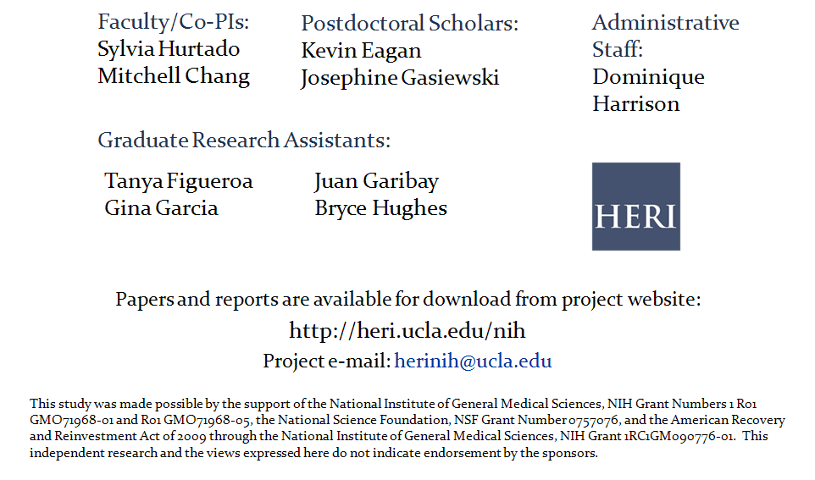
Contact Information

