Slide 1
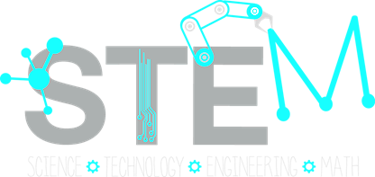
Improving … … ………………………………………..…
Degree Attainment Rates:
Lessons from Hispanic Serving Institutions
Tanya Figueroa, Ana Karen Gomez, Sylvia Hurtado
American Association of Hispanics in Higher Education, Inc.
March 2017| Irvine, CA

Slide 2

STEM Completion Rates* by Institution Type
(N= ALL 56,499 students)
Type | 4-Year | 5-Year | 6-Year
HSI | 10.0 | 22.2 | 28.6
Emerging HSI | 26.7 | 44.1 | 47.5
PWI | 23.7 | 38.0 | 42.6
* Percentage of STEM Aspirants Who Completed a STEM Degree
Notes:
Pass out note cards and then collect? This will be used for the end activity.
CPP (3):
California State Polytechnic University – Pomona is a public 4-year Master’s institution situated in an urban setting and has an undergraduate enrollment of over 20,000 students with transfer students making up nearly 40% of the student population. The institution is considered moderately selective with an acceptance rate of 52%. The campus is primarily nonresidential with the majority of students commuting to campus; indeed, only 11% of undergraduate students live in college-owned housing. There are roughly 1,155 faculty members at CPP, of whom 49% are full-time, with a student-faculty ratio of 28:1. The university is a predominantly teaching institution, offering bachelor’s, master’s and doctoral degrees in over 100 majors including several STEM majors like animal sciences, biological sciences, computer science, engineering, mathematics, and physical sciences. The majors with the highest enrollment are engineering, business administration, and science. As a polytechnic university, the institution values a ‘learn by doing’ pedagogical approach to teaching, learning, and practice.
FIU (1):
FIU is a public institution nestled in an urban city and has a high undergraduate enrollment but also has a high graduate coexistence. The institution is considered a selective, higher transfer-in, primarily non-residential institution. Roughly 8% of undergraduate students live in college-owned housing. There are roughly 2,255 faculty members of whom 54% are full-time, with a student-faculty ratio of 26:1. The university offers a variety of majors including several STEM majors like biological/life sciences, computer and information sciences, engineering, health professions, mathematics and statistics, physical sciences. With respect to the incoming characteristics of the freshman class, the average SAT Math score of students that were accepted was 551 and the average high school GPA for first-year freshmen was 3.91. In-state tuition for the full academic year is roughly $6,100. Also the university boasts some impressive achievements such as being awarded 1,312 STEM bachelor’s degrees in the 2012-2013 school year, 76% of which were awarded to underrepresented minorities.
FIU was chosen for participation because not only did it rank highly in our analysis but further investigation of the institution’s website via a webscrape revealed the campus was engaged in several notable interventions/initiatives to increase the success of students in STEM. These interventions are broad reaching and target undergraduates, institutional change and faculty with professional development, and/or focus on creating partnerships with the K-12 community, particularly in creating pipelines to higher education
RUN (2):
Rutgers University - Newark is a four-year, medium-size, primarily non-residential, public university with higher research activity (Carnegie classification: R2) located in the urban center of downtown Newark, New Jersey. Student enrollment is highly diverse, representative of the campus’ surrounding community, and reflective of the greater New York City metropolitan area.The campus openly prides itself on being “the most diverse campus in the nation.”
The Rutgers’ legacy stretches back to its 1766 New Brunswick beginnings as Queens College, one of the United States’ original nine colonial colleges. The Morrill Act of 1862 launched Rutgers College’s’ earliest educational divisions of science, technology, agriculture, and engineering when it was awarded status as New Jersey’s only land-grant institution. In the mid-twentieth century, the state legislature established Rutgers as the State University of New Jersey, consolidating existing institutions throughout the state into one public system of higher education. Today, the Rutgers University - Newark campus, previously the University of Newark (f. 1908), comprises one of four Chancellor-led divisions within the Rutgers system, with the three others being the flagship New Brunswick campus, the Camden campus, and a consolidated unit of state-run medical and other health sciences facilities known as Rutgers Biomedical and Health Sciences (RBHS).
RU-N is a doctoral research university with majority undergraduate enrollment. Most of its undergraduates receive Bachelor’s degrees in the professions (business, criminal justice, public affairs, education), but all students receive a traditional liberal arts and science education. Degrees in STEM are awarded by the following academic departments: Biological Sciences, Earth and Environmental Sciences, Chemistry, Mathematics and Computer Science, and Physics. Through internal articulation agreements with RBHS and external partnerships with institutions such as the adjacent New Jersey Institute of Technology (NJIT), students who initially enroll at RU-N are able to pursue pre-med, pre-engineering, allied health, and nursing degrees.
RU-N’s leadership recently changed with the appointment of Nancy Cantor. Nancy Cantor, the first female Chancellor of Rutgers University—Newark, is a distinguished leader in higher education. She is leading implementation of the institution’s first strategic plan, which is designed to leverage the university’s many strengths, particularly its exceptional diversity, tradition of high-impact research, and role as an anchor institution in Greater Newark. The plan sets priorities to invest resources to build the university’s strengths in merging excellence and opportunity, and in the words of Cantor, to reinvigorate RU–N’s abiding “commitment to pushing forward ambitiously and assertively to be that diverse urban research institution that leaves no stone unturned in its impact — on scholarship, social mobility, and urban civic life.” The initiatives include a listening tour, strategic planning process, and introduction of a new naming convention and logo for the university that reflect changes taking place across Rutgers University, as well as the naming of a leadership team in the chancellor’s office

Slide 3
Percentage of 2004 STEM Aspirants Who Completed STEM Degrees in Four, Five, and Six Years, by Race/Ethnicity
% of All STEM Aspirants
Data Source: 2004 Freshman Survey, 2010-11 National Student Clearinghouse; HERI, UCLA
Notes:
Many students take longer than 4 years to graduate. A majority of students who initially plan to major in STEM never earn a STEM degree, although rates are the most poor among URM students – indicating the persistent need for interventions for these groups.

Slide 4
3 Hispanic Serving Institutions

Slide 5
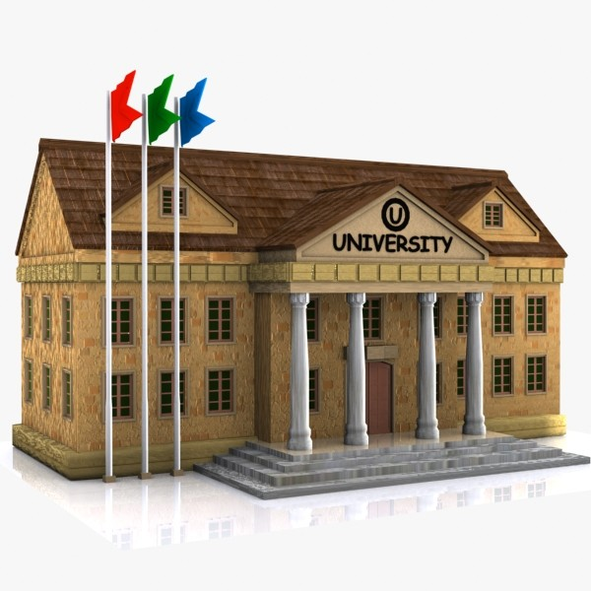
Case Study Sample
R1 Large HSI | R2 Small HSI | Master’s Comprehensive HSI
55,000 (61% Latino) | 11,800 (25% Latino) | 24,000 (37% Latino)
R1 Highest research activity | R2 Higher research activity | Not-classified Master’s College Teaching University
public | public | public
47% admittance rate | 65% admittance rate | 52% admittance rate
Deep South | North East | West Coast
Interviews with faculty, administrators and program directors
Notes:
15-25 Interviews with faculty, administrators and program directors
R2: 7,713 undergraduate
FIU: 7,800 undergraduate

Slide 6
Key Features of the 3 HSIs

Slide 7
HSIs Embrace Student Diversity
All institutions embraced the fact that their student body is becoming more diverse (immigrant, first generation students, URM, CC transfers, etc) 1, 2, 3
Leadership professed a desire to hire:
  more diverse faculty 2, 3
  faculty who like to teach and include diverse students in their research 1, 3
Diversity was reinforced when leadership was vocal about the importance of diversity 2
  In all, however issues pertaining to diversity seemed to be everyone’s job 1, 2, 3
“When we hire faculty… we are looking for somebody who really loves being with students, who likes teaching students, who’s not afraid to work with people from different diverse backgrounds.”
-Professor Emeritus in Biology
Master’s Comprehensive HSI
Note: Institutions for which the finding is applicable is notated by the following:
1= R1 Large HSI; 2= R2 Small HSI; 3=Masters Comprehensive HSI

Slide 8

HSI Partnerships with Community
Purpose of K-12 STEM pipeline programming with underrepresented students: 1 2 3
    ignite early interest in STEM
    reinforce STEM interest along multiple stages
    provide a transition to the university
Purpose of partnerships with surrounding community colleges:2 3
    facilitate transfer
    introduce community college students to research
    articulation agreements
Note: Institutions for which the finding is applicable is notated by the following:
1= R1 HSI; 2= R2 HSI; 3=Masters Comprehensive HSI
Notes:
K-12 pipeline programming
POMONA:
Upward Bound (summer; feeder program); Talent Search
Outreach to Pomona Unified school district
Summer camp for 4-7 year olds
RUN:
Rutgers Teachers Scholars programs: 8th graders
LSAMP: K-12 children;
*Dual credential program with HS
FIU:
*Dual enrollment program with HS (highest # of students enrolled in dual enrollment in the nation)
STEM summer programs for K-12
Annual engineering week: target URM
Engineering on wheels: tutoring at high schools
Annual engineering expo K-12
Partnership with Miami County Public Schools: NSF and army funded outreach
Partnerships with surrounding community colleges
Ex. Bridges to Bachelor mentoring. (Rutgers)
Mentoring wherein STEM undergrads mentor CC students who are interested in STEM and also possibly attending Rutgers 64 65 (Rutgers)
RUN:
Ex. Bridges to Bachelor mentoring. 5 CC partnership
Mentoring wherein STEM undergrads mentor CC students who are interested in STEM and also possibly attending Rutgers 64 65 (Rutgers)
LSAMP: CC students can become affiliated scholars
Pomona
Road maps to transfer for CC, grant based program but ended when grant did (in general across the campuses a lot of programs end when the grant ends, that’s a problem, how can they get more of them institutionalized?”

Slide 9

Comprehensive STEM Programs for Students
Offer holistic services such as: 2, 3
  tutoring
  advising
  workshops
  study groups
  research opportunities
  mentoring (either peer-to-peer and/or from faculty)
Closely monitor students’ success 2, 3
Have great expectations of students 2, 3
Require partnerships across campus 2, 3
At one institution, two comprehensive programs were budget line items, which enabled them to expand with external grants 3
Note: Institutions for which the finding is applicable is notated by the following:
1= R1 Large HSI; 2= R2 Small HSI; 3=Masters Comprehensive HSI
Notes:
LSAMP – (Rutgers)
Math boot camps
Minority Engineering Program (MEP) now called Maximizing Engineering Potential (CPP)
It is a line items on the budget 546
Science Educational Enhancement Services (SEES) 546 (CPP)
Targets under-represented students including first generation students and those that are economically disadvantaged
It is a line items on the budget 546

Slide 10
Undergraduate Research Opportunities
  Research opportunities vary greatly by department & by institution 1, 2 ,3
Required course based research linked with faculty mentors 1
Faculty connect students to internships/research networks 2 3
  Center for Undergraduate Research: 3
    Connects students to research opportunities
    Teaches students how to approach faculty
    Provides grants/stipends for faculty doing research with students and small funds for student researchers
      Conveys that faculty who mentor and conduct research with students are highly valued by the university
Note: Institutions for which the finding is applicable is notated by the following:
1= R1 Large HSI; 2= R2 Small HSI; 3=Masters Comprehensive HSI
Notes:
Important because research programs can only impact a finite number of students & involvement in research is usually initiated by the student
Faculty commonly use their own networks to connect students to colleagues in industry and at other universities so students can obtain coveted research and internship opportunities (Rutgers & CPP)
Some departments have made a formalized research class mandatory (FIU - chemistry)
Provides the opportunity for informal mentoring by faculty who supervise the research and mentoring from peers within the same lab
Research opportunities in STEM can be part of the ethos of the institution and abundant OR can vary greatly department-by-department if some faculty believe in inviting undergrads into their research, while others do not (CPP)
Faculty do self-evaluations annually, and there is a spot for them to list the undergraduate researchers that they’ve taken on and mentored; so it’s an expectation (FIU)
It is helpful when there is a Center for Undergraduate Research (CPP)
because research programs can only impact so many students
and involvement in research is usually initiated by the student who asks a faculty to work with them so students need help connecting to research opportunities (FYI same at FIU)
started with a CCRA grant, once the grant ended the program was institutionalized by upper-level administrators
The Research Center at CPP provides grants or modest stipends for faculty doing research with students which helps pay for faculty’s time and extra lab equipment (i.e. chemicals) to fund the project
Sends a message that the university values when faculty conducts research with and mentors students

Slide 11
Innovations in the Classroom

Slide 12
Innovations in the Classroom
Some departments making more strides than others (i.e. physics) 1, 3
From lecture towards structured inquiry-based learning experiences: 1, 2, 3
    Students apply concepts in team based learning groups
    “Learn by doing” - Application focus not only abstract theory
    Achieved via the use of field work, labs, and hands-on activities
    Allows for students to be engaged in the material immediately
Flipped & hybrid courses: 1, 3
    Class time is reserved for engaging activities, not delivery of content
    Lectures and readings are offered online
Accepting failure as part of learning & having a growth mindset 2
“High touch” culture for making contact with students falling behind in the classroom via text, email to convey concern for progress 1, 3
Note: Institutions for which the finding is applicable is notated by the following:
1= R1 Large HSI; 2= R2 Small HSI; 3=Masters Comprehensive HSI
Notes:
(rather than just memorize content)
There is a move toward structuring inquiry based learning experiences inside the classroom wherein students can apply the concepts they learn (rather than just memorize them) and become engaged in the material immediately (rather than traditional lecture).
Achieved via the use of field work, labs, and hands-on activities – (Rutgers & Cal Poly “Learn by doing” & FIU)
Also a move toward promoting team-based student learning and collaboration (Rutgers & CPP & FIU)
In some cases the innovation in the classroom was changing from a lecture classroom to a flipped or hybrid classroom – part online/part in classroom. With the help of LAs, class activities are based around concepts, not content per se. This elicits much more student participation and engagement in course material. Lectures and readings are offered online. (CPP & FIU)
Interesting concept of teaching students to embrace failure and having a growth mindset (Rutgers)
Some departments are making more strides than others in the use of innovative teaching techniques (CPP - physics, FIU - physics)
“High touch” in the classroom (FIU & CPP)
This means reaching out to students (email, after class, via text) who are struggling and falling behind, talking to them to find out what is going on, and possibly getting them to come to office hrs.

Slide 13
Peer Learning Assistant (LA) Program 1,3
  What do LAs do?
    Undergrad students paid to facilitate learning & lead activities in classes
    Trained through a one semester pedagogy seminar in Science education
    Meet weekly with faculty to discuss learning goals, plan activities, and address the misconceptions/ difficulties of current students
  What is the LA Program?
    It started in Physics, spread to Math, and is now available in other STEM disciplines
    LA Program Directors talk to department chairs in STEM disciplines to determine what courses need additional support
    LAs contributed to improvements in pass rates of math and physics
Note: Institutions for which the finding is applicable is notated by the following:
1= R1 Large HSI; 2= R2 Small HSI; 3=Masters Comprehensive HSI
Notes:
Learn by doing: the application of theory

Slide 14
*Most Unique Innovation
STEM Transformation Institute:
Interdisciplinary hub (people from different departments discuss how students can get the most out of their STEM classes outside their major)
STEM personnel provide coaching & support for STEM pedagogy
Aims to hire faculty who will conduct research in science education
Helps with scaling and coordination of pedagogical reform efforts
Houses the ‘Peer Learning Assistant Program’
Initially sponsored by a grant, later institutionalized
*Only found in case study for R1 Large HSI
Notes:
STEM Transformation Institute
Offers STEM personnel who are well equipped to provide coaching and support around best practices in STEM pedagogy (i.e. encouraging faculty to use active learning and student engaged teaching)
Helps with scaling and coordination of pedagogical reform efforts.
It’s an interdisciplinary hub wherein people from different departments (physics, math, chemistry, engineering) talk about how students can get the most out of their STEM classes that are outside of their major 503
One of the institute’s aims is toward hiring faculty who will conduct research in science education
The hope is that this research will help transform classes via the use of best practices and data driven practices in teaching. 267
The Institute was initially sponsored by an HHMI, Howard Hughes grant that is in its second cycle. Later, upper administration became invested in the institute and institutionalized it.
Institutionalized for a total of one year, but much older than that 250
Part of the monies of the HHMI grant provide faculty a month of summer salary OR a one-course teaching reduction during the academic year to learn about pedagogy and reform a course. 213
Houses the ‘Peer Learning Assistant Program’ (started in 2007)
The LA Program works with the STEM Transformation Institute to ensure resources are going to certain courses to improve them. 229
LAs meet with the faculty every week for planning focused on learning goals of class time, activities, and misconceptions/ difficulties current students taking the class have
LAs are undergrad students that are paid to be in the classroom to facilitate learning and lead some activities.
To train, LAs take a one semester pedagogy seminar course in science education.
LA Program started in Physics, spread to Math, and is now available in other STEM disciplines.
Has made improvements in the pass rates of math and physics
LA Program talks to department chairs in STEM disciplines to determine what courses need changing
A low effort way to better support students in a course wherein the faculty is not yet ready to transform the course using active learning pedagogy is to start LA sessions out of class. 437

Slide 15
Innovations in Math
Remedial Summer Program (for students with math deficiencies) 3
Extended math sections (twice as long) 1
More interactive classes 1
Standardizing class sections: 1
    Drastically reduced number of people teaching different sections of one class
    Instructors hand-selected based on track record of successful teaching
    Instructors work together in teams to design assessments, make decisions on teaching methods, and set lab policies
  Adaptive learning software (ALEKS) “Mastery Math Lab:” 1, 2
    Students do math problems using interactive computer software either in a lab 1 or on-line 2
    Helps assess knowledge and lets students see what content areas they have mastered and alternatively which areas needs further practice
    Personalized, on-demand assistance 1, 2
    Mandatory student participation 1, 2 3-4 hours per week 1
Note: Institutions for which the finding is applicable is notated by the following:
1= R1 Large HSI; 2= R2 Small HSI; 3=Masters Comprehensive HSI
Notes:
Created with the belief that practicing math problems using interactive computer software combined with personalized, on demand assistance and mandatory student participation is the key to success
to produce a consistent, cohesive learning experience:
Innovation in Math
Adaptive learning software (ALEKS) – (Rutgers)
Helps assess knowledge and lets students see what content areas they seem to have mastered and alternatively which areas needs further practice.
Represents an additional learning path that is offered online
Especially useful for helping students placed in remedial math to get up to speed
Remedial Summer Program (Early Start) for students with math deficiencies (CPP)
Incoming students who aren’t at college ready skill level in math can begin developmental math before they matriculate in the summer. This helps them move along more steadily because when they begin college in the fall, they take credit-bearing courses instead of remedial classes
Students who need 2 or more terms of remedial math before they are at college level are invited to participate. Amounts to roughly 1/3 of students at CPP
Students are provided with financial aid to pay for the classes
For this program to run it takes collaboration from people from several offices including admissions, the financial aid office, the test center, the math department, etc.
Key changes in FIU’s Math Department (FIU)
Created sections called 'extended sections' that meet twice the amount of time as regular sections. Students in these sections usually perform a little bit better than student in the regular length sections, because they meet with the instructor more often. Unfortunately, FIU cannot do this for all sections because of the lack of space. 443
It was easier to improve and standardized the actual teaching, expectations of students, and learning assessment in introductory math classes when the number of people teaching the different sections of one class was drastically reduced. It also helped to hand select the people teaching the reformed intro classes and sticking to those who had a long track record of successfully teaching algebra.
The Math Gym aka Mastery Math Lab was created
This lab was created with the belief that interactive computer software combined with personalized, on-demand assistance and mandatory student participation is the key element of success.
In this lab students spend time doing math exercises/ math homework. In this way they can get help from trained peer LAs and/or faculty when they need it rather than trying to do homework alone at home.
All students in algebra are required to attend lab at least 3-4 hours per week.
The Director of the Master Programs at FIU also works with faculty who teach algebra, pre-calculus, and trig to make these classes more interactive.
The Director has math faculty work together in teams to produce a consistent cohesive learning experience for students. Together faculty design assessments for student learning, make decisions on teaching methods, pedagogies, set lab policies, and write the syllabi in non-aggressive language.
Results? See quote below
We've used the same tests, we’ve used the same material and seen that increase [in the number of students that pass the class]. We’ve also seen a dramatic decrease in the number of students that drop the class. So we know that we’re being successful in [improving] the students' feelings of self-efficacy… so that even if they're not passing the class at least they don’t feel like they’re a failure and therefore are going to drop out. So when we had these successes.. we tested this for a number of years and then we went whole scale into college algebra in the fall of 2012. All the college algebra classes use this model. 75

Slide 16
Results of Pedagogical Innovations
Referring to Math faculty working in teams to redesign courses combined with using adaptive learning software in a math lab staffed with faculty and peer learning assistants…
“We've used the same tests, we’ve used the same material and seen that increase [in the number of students that pass the class]. We’ve also seen a dramatic decrease in the number of students that drop the class. So we know that we’re being successful in [improving] the students' feelings of self-efficacy… so that even if they're not passing the class at least they don’t feel like they’re a failure and therefore are going to drop out. So when we had these successes.. we tested this for a number of years and then we went whole scale into college algebra in the fall of 2012. All the college algebra classes use this model.”
– Director of the Master Math Program R1 Large HSI

Slide 17
Changing Faculty Roles and Professional Development

Slide 18
Changing Faculty Roles
R1 Large HSI
Switched to relying only on fixed term, full-time adjunct faculty
If we have fulltime instructors, we can hold people accountable, we can have them participate in professional development, etcetera… Once they are hired, they are told, ‘You are going to be a part of transforming classes, that’s going to be part of your role… This is not [just] teaching classes and going home. The expectation is that you'll meet with the people that you’re working with. The expectation is that you’ll participate in the Math Department.. you’re going to be serving on committees... This is going to be your profession, rather than a way of making money.’
– Director of the Master Math Program, R1 Large HSI
Notes:
Another institution changed the roles of instructors from an individual who just teaches a single class to an individual who is fulltime (with a long term contract) and embedded within the functions of the department (FIU)
By relying on fulltime instructors, the institution simply never hired back adjuncts that had a history of horrible pass rate and kept the ones that were dedicated to teaching.

Slide 19
Changing Faculty Roles
R2 Small HSI
Created a ‘master teacher’ full-time career track with steps for promotion that comes with a higher teacher title.
    Evaluation based upon teaching portfolios and service, not so much research.
They see their passion as teaching and interacting with students, and they love it. They're almost relieved that now universities are looking for them because they don't have that publish-or-perish hatchet hanging over their heads, and they can actually do what they love, which is focusing on students. What you have in departments then is you have people being hired in who's primary focus is on student success, student learning, and teaching, and they serve a very vital role in the department.
– Associate Dean of Educational Initiatives for the College of Arts and Sciences,
R2 Small HSI

Slide 20

Changing Faculty Roles
Masters Comprehensive HSI
Because it is a teaching institution, all professors are expected to be committed “teacher-scholars”
  We emphasize teaching and the quality of teaching here in our tenure and promotion process much more than we do research. We like faculty to have research experience both for their own development and also because that keeps them current in their fields and they bring that into classroom. But you will not be able to get tenure here if you're not a good teacher and we evaluate that in various ways from student evaluations and peer evaluations and reflections of the candidates themselves on their teaching and we look for improvements in that over time. And when we're recruiting faculty we really emphasize that you're not going to be happy here as a faculty member if you don’t enjoy teaching and if you do not have real commitment to teaching.
- Provost and Vice President for Academic Affairs, Master’s Comprehensive HSI
Notes:
Contrastingly at Cal poly, professors were expected to be committed “teacher-scholars,” since the university was a teaching institution and not highly research intensive. (CPP)
Because there is no dual track, faculty can’t get tenure if they are also not a good teacher and demonstrate a real commitment to teaching.
“We emphasize teaching and the quality of teaching here in our tenure and promotion process much more than we do research. We like faculty to have research experience both for their own development and also because that keeps them current in their fields and they bring that into classroom. But you will not be able to get tenure here if you're not a good teacher and we evaluate that in various ways from student evaluations and peer evaluations and reflections of the candidates themselves on their teaching and we look for improvements in that over time. And when we're recruiting faculty we really emphasize that you're not going to be happy here as a faculty member if you don’t enjoy teaching and if you do not have real commitment to teaching. That you know leads to a certain selection in terms of the kind of faculty that we have here.”

Slide 21
Faculty Professional Development
  Teaching Centers - act as a bridge between education research in STEM and pedagogy to help faculty improve their teaching 1 3
    Offers workshops and summer institutes that teach faculty:
      How to improve their classes
      About cognition and developmental stages of students and how that impacts learning
      How to engage in “culturally relevant” teaching
      How to work with diverse students, the benefits of diverse labs, and the benefits to students
    Incentives: release time, summer salary or stipend to improve classes
Note: Institutions for which the finding is applicable is notated by the following:
1= R1 Large HSI; 2= R2 Small HSI; 3=Masters Comprehensive HSI
Notes:
Teaching Centers
- acting as a bridge between education research in STEM and pedagogy to help faculty improve their
Offers workshops and summer institutes that teach faculty:
how to improve their classes
About cognition and developmental stages of students and how that impacts learning
Stresses not only teaching, but culturally sensitive teaching
Offers faculty training on how to work with diverse students ) (low-income first gen students, underrepresented minorities, etc.) including the importance of working with diverse students and the benefits of diverse labs
Offers grants or small stipend to improve classes
Incentives for participating in these teaching improvement related activities includes release time, summer salary, or some type of stipend

Slide 22
Starting and Scaling Change

Slide 23
Power of Grants
  External grants tended to provide the initial money for the change process 1 3
  Once the innovations are shown to work, the institution becomes invested in sustaining the change and institutionalizes the efforts 1 3
  Leadership can signal that they promote innovation by providing seed grants to fund good ideas that are student-centered and/or focused on teaching. This sparks more excitement over new ideas. 2
With the previous chancellor, money was not given to fund projects. If you had a good idea – good luck. With this Chancellor, it was the first time in my life [here] when there was a dollar amount [given]… 200 cents on the dollar…. [for your project proposals]. The idea that was really sent down to the faculty was, ‘If you have a good idea, the administration is now going to fight to help you fund it.’
– Assistant Professor in Biology
R2 Small HSI
Note: Institutions for which the finding is applicable is notated by the following:
1= R1 Large HSI; 2= R2 Small HSI; 3=Masters Comprehensive HSI

Slide 24
Administrators’ Role in Supporting Innovation
1 2 3
To scale change, admin needs to:
    Recognize and celebrate good work
    Provide resources (money, knowledgeable staff to act as support, faculty instructor lines, funds to change classroom spaces, & stipends and course releases as incentives)
    Remove any potential barriers
    Facilitate conversations about the problem, the plan to address it, and the resources that will support faculty in creating change (via retreats, town halls, suggestion boxes, guiding discussions with trustees, attending departmental faculty meetings)
    Urge change in introductory STEM classes by sharing expectations that these courses must improve
Note: Institutions for which the finding is applicable is notated by the following:
1= R1 Large HSI; 2= R2 Small HSI; 3=Masters Comprehensive HSI
Notes:
So even though change often *started* bottom-up, for the change to be scaled, it needs upper admin to provide: (Rutgers, CPP, & FIU)
public and private recognition and celebration of good work
resources (money, knowledgeable staff to act as support, faculty instructor lines, funds to change classroom spaces, & stipends and course releases as incentives)
remove any potential barriers
facilitate conversations about the problem, the plan to address it, and the resources that will support faculty in creating change (via retreats, town halls, suggestion boxes, guiding discussions with trustees, attending departmental faculty meetings)
send the message via conversations and the strategic plan that diversity, teaching, and research with students is important and expected
There needs to be the right mix of faculty staff and admin involved
Leadership can signal that they promote innovation by providing grants to fund good ideas that are student-centered and/or focused on teaching. This sparks more excitement and innovative ideas. (Rutgers- Seed Grant Program)

Slide 25
How Change Starts 1 3
  Experimentation:
    Stories of how a professor/instructor experiments with different pedagogical methods (ex. active learning, flipped classes) and collects data on this
      Some secured external grant to support him or her in the initial stages of reforming pedagogy.
      It is not uncommon for sparks of innovation to be happening in more than one department.
  Dissemination of Idea: (Once teaching innovation is shown to work)
    The faculty innovator (this person is usually a well-liked person, which highlights the power of relationships in creating change) showcases work to their dean and provost OR
    President or Provost naturally takes notice of improved success of students, realizes that this path is beneficial to the institution, and asks for more information
Note: Institutions for which the finding is applicable is notated by the following:
1= R1 Large HSI; 2= R2 Small HSI; 3=Masters Comprehensive HSI
Notes:
The change process seemed to follow the following process at (FIU & Rutgers)
One superstar or very curious professor/instructor experiments with different pedagogical methods (ex. active learning, flipped classes) and collects data on this. This person may even get an external grant to support him or her in the initial stages of reforming pedagogy. It is not uncommon for sparks of innovation to be happening in more than one department.
Once teaching innovation is shown to work (as evidenced by data collected on learning gains of students), the faculty innovator showcases it to upper admin (this person is usually a well-liked person, which highlights the power of relationships in creating change) OR admin naturally takes notice of improved success of students, realizes that this path is beneficial to the institution, and asks for more information.

Slide 26
Gaining Momentum
  3. Decision and Plans Made to Implement Idea:
    President or Provost make it a priority to innovate pedagogically, creates plans with the innovator to spread the innovation, and provides funds to maintain momentum/institutionalize the change
    Plans for change must include faculty input and empower faculty to make the changes outlined via the existence of sufficient support structures
    Innovators around campus start to talk to each other and share ideas
  4. Creating More Faculty Buy-In:
    It is necessary to convince additional faculty (by sharing success stories) that there are more effective ways of teaching, that making these pedagogical changes retains students, and that these practices are fun to implement in the classroom
Notes:
As a result, admin gets behind the change by determining that they want to make it a priority to innovate pedagogically, creates plans with the innovator to spread the innovation, and provides funds to maintain momentum/institutionalize the change. Pockets of innovation may start to talk to each other and share ideas at this point (Interdisciplinary collaboration FIU).
The original faculty innovator, along with admin, then have to convince additional faculty (by sharing success stories) that there are more effective ways of teaching, that making these pedagogical changes improves student learning, and that these practices are fun to implement in the classroom.
Any announcement of plans for changes must make faculty feel as if they can provide input and that they will be empowered to make the changes outlined via the existence of sufficient support structures.
Directives cannot be forced because faculty do not want to be told what to do and academic freedom prohibits forced scripts on how to teach a class.

Slide 27

Scaling the Change
  5. Training faculty in the Innovation:
    This requires a great deal of support from a team that is knowledgeable on pedagogical innovation and interdisciplinary collaboration
  6. There also needs to be some intentional effort in continuously training faculty to sustain reform efforts
Notes:
By doing all of the above, departments increase gradually the number of sections it offers using the new pedagogical innovations, eventually increasing the number of intro classes using the innovation, and later spreading the innovation into upper division courses. Eventually we find that the innovation spreads to other departments (because either the department becomes interested in the change after seeing improved student results or admin wants other departments to change too).

Slide 28


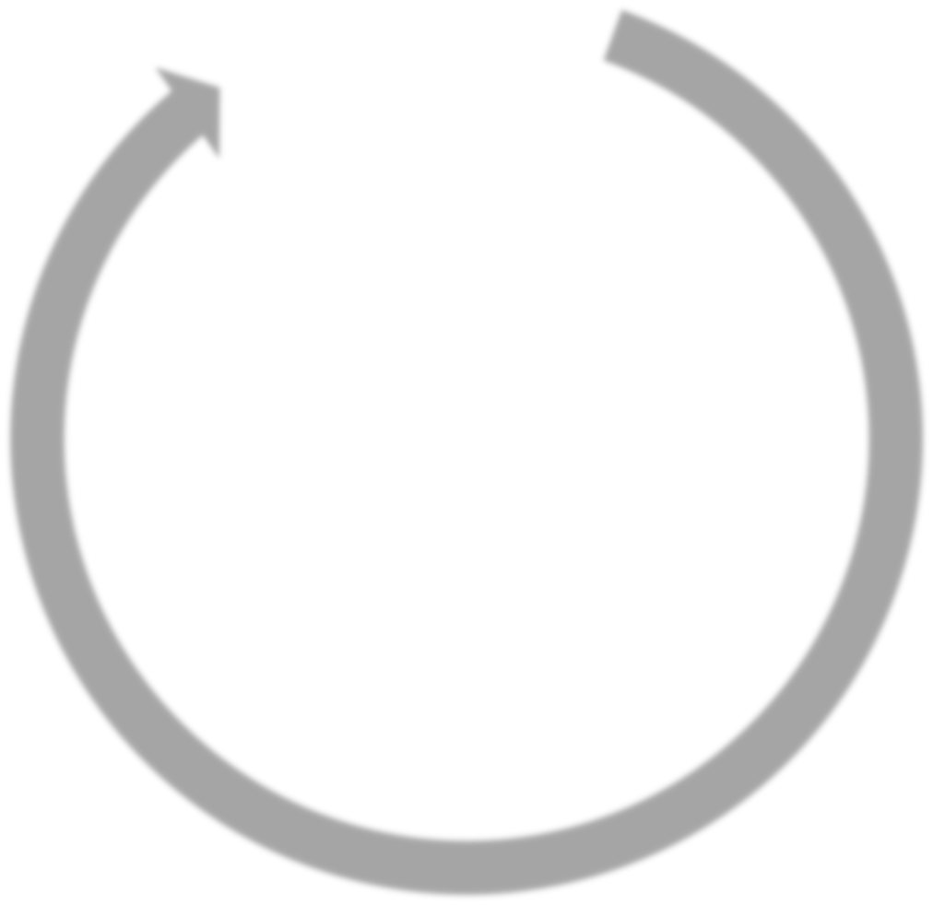






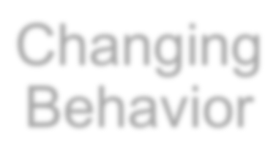

Elements Of Organizational Learning and Transformation
Data/
Research
External Pressures
Accountability
Sustaining Change
Changing Mindsets
Navigating Power Dynamics
Training/ Development
Buy-in and Relationships
Changing Behavior
Diffusing Knowledge

Slide 29
Contact Us
Papers and reports are available for download from project website:
http://heri.ucla.edu/nih
Project e-mail: herinih@ucla.edu
Faculty/Co-PIs:
-Sylvia Hurtado
-Kevin Eagan
Postdoctoral Scholar:
Tanya Figueroa
Administrative Staff:
Dominique Harrison
Graduate Research Assistants:
-Ashlee Wilkins
-Tracy Teel
-Damani White-Lewis
-Krystle Cobian
-Ana Karen Gomez

