Slide 1

Stayers, Swirlers, and Re-Enrollers:
Understanding the Trajectory of College Students
SYLVIA HURTADO
LINDA DEANGELO
CHELSEA GUILLERMO-WANN
SUTEE SUJITPARAPITAYA
AURORA KAMIMURA
AAC&U
OCT. 22, 2010
HOUSTON, TX
HIGHER EDUCATION RESEARCH INSTITUTE AT UCLA
home of the COOPERATIVE INSTITUTIONAL RESEARCH PROGRAM
Notes:
Stayers = Students who continuously enrolled in subsequent terms following their entering term for at least one course at the same institution
Swirlers = Students with multi-institutional attendance that is multi-directional

Slide 2
Introduction
Obama’s 2010 “American Graduation Initiative”
Current State of Degree Attainment – DOE
HERI’s Current Degree Completion Projects
Purpose: Provide data and discussion directed at ensuring student retention and degree attainment
Limitations:6 yr data coming, 2yr starters DLE only

Slide 3
Data Sources
Diverse Learning Environments Pilot Survey (DLE)
The CIRP Freshman Survey with National Clearinghouse (DARCU)
2010
N =5,010
68.3% Female
58.4% Students of Color
33.6% Age 25+
39.7% Currently at 2-yr
2004-2008
n = 276,234*
53.7% Female
26.6% Students of Color
0.2% Age 25+
0% Started at 2-yr

Slide 4
4-Year Degree Completion and Retention Rates
2004-2008
Notes:
Traditional Enrollment = Students who continuously enrolled in subsequent terms following their entering term; 21.9% / 42.2%
Stayers = students who graduated from the same institution they started at, but may have taken courses elsewhere or even stopped out; 35.4% / 60.4%
Swirlers = Students with multi-institutional attendance and more than one change
Re-Enrollers = students who stop-out and subsequently return to any institution
Traditional, Stayers, Swirlers & Re-Enrollers: 39.9% / 83.2%

Slide 5
4-Year Degree Completion and Retention Rates at Original 4-Year Institution by Race/Ethnicity, 2004-2008
Notes:
Note: 4-year retention includes all students who earned a degree in 4yrs, plus those who continue to persist in college
Asian American 46%, 70%
White 43.8%, 63.6%
Multiracial 37.5%, 57.9%
Latina/o 30.65, 56.4%
African American 23.6%, 50.1%
American Indian 19.0%, 43.9%

Slide 6
Predicting 4-Year “Stayers”
4-YEAR DEGREE COMPLETION
AT ORIGINAL INSTITUTION
(POSSIBLE MOBILITY)

Slide 7
4-Year Degree Completion “Stayers”
Notes:
4-year degree completion has been dropping, entering cohort of 1994 36.6%, entering cohort of 1985 39.9%
Public 37.4%
Private University 56.1%
Public 4-Year College 22.4%
Private 4-year college 46.6%
Catholic 4-year college 38.3%
Other Religious 4-year college 39.2%
All Institutions 35.4%
4-year retention
Public 69.1%
Private University 66.9%
Public 4-Year College 54.2%
Private 4-year college 61.1%
Catholic 4-year college 49.3%
Other Religious 4-year college 49.8%
All Institutions 60.5%

Slide 8
Predicting 4-Year Degree Completion at Original Institution
 | African American | Latino/a | Asian American | White
Activities in the Last Year of High School
Used Internet for Research/Homework |  | + |  | +
Reasons for Attending Particular College
HS Guidance Counselor Advised Me | -
Pvt Guidance Counselor Advised Me | +
Wanted to Live Near Home |  | + | + | +
Graduates Get Good Jobs |  | +
Rankings in National Magazine |  |  | - | -
Information from Website |  | +

Slide 9
Predicting 4-Year Degree Completion at Original Institution
 | African American | Latino/a | Asian American | White
Reference Major: Undecided
Major: Bio Sciences |  |  | - | -
Major: Physical Sciences | - | - | - | -
Major: Social Sciences | + | + | + | +
Major: Business |  | + | + | +
Possible Future Activities
Participate in Student Government | +
Participate in Community Service | + | +
Participate in Study Abroad Program |  | + | - | +

Slide 10
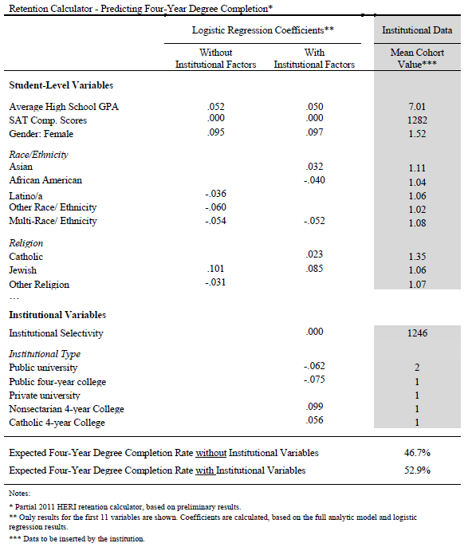
HERI Retention Calculator
Predicting
4-Year Degree Completion at Original Institution

Slide 11
Degree Completion Calculator Examples
Private University
Medium Selectivity
54% expected degree completion for African American students
55% expected degree completion for White Students
Public College
Medium Selectivity
33% expected degree completion for African American students
28% expected degree completion for White Students

Slide 12
Swirlers and Re-Enrollers
COLLEGE STUDENT ENROLLMENT MOBILITY
Notes:
Enrollment Mobility: The enrollment in more than one undergraduate institution at any time

Slide 13
Enrollment Mobility: Definitions
Traditional Enrollment: Continuous enrollment at only one institution (Goldrick-Rab, 2006)
Fluid Movement: Continual enrollment between two or more institutions (Goldrick-Rab, 2006)
Interrupted Enrollment: Discontinuous enrollment (stop-out) from only one institution (Goldrick-Rab, 2006)
Interrupted Movement: Discontinuous enrollment (stop-out) between two or more institutions (Goldrick-Rab, 2006)

Slide 14
Transfer Mobility: Definitions
Vertical Transfer: Begins at a 2-yr institution and subsequently enrolls in a 4-yr institution (Cohen & Brawer, 2008)
Reverse Transfer: Begins at a 4-yr institution and subsequently enrolls in at least one two-year institution (see Townsend, 1999)
Horizontal Transfer: Begins at one type of institution and enrolls in at least one additional same-type institution during a regular term
  2 to 2 Year
  4 to 4 Year (see Li, 2010)
Notes:
For these analyses, reverse transfer does not include students who temporarily drop in to a 2yr from a 4yr

Slide 15
Select High and Low Enrollment Mobility by Racial Groups in DLE and DARCU Data Sets
Traditional Enrollment
  White students highest (~50%)
Two or More Institutions
  White students lowest (~36%)
Any Type of Stop-Out
  African American students highest (~40%)
Interrupted Enrollment
  African American highest (~17%)
  White students lowest (~11%)
Vertical Transfer
  Asian American students highest (~9%)
  Latina/os lowest (~6%)
4-to-4 yr Transfer
  Latina/os lowest (~11%)

Slide 16
Proportion of Students Displaying Enrollment Mobility Patterns & By 4-Year Degree Completion
Enrollment Type | DLE | DARCU
 | Overall % | Overall % | 4yr Degree %
Any Type of Movement | 40.6% | 36.5% | 12.0%***
Any Type of Interruption | 28.5% | 36.1% | 7.4%***
Traditional Enrollment | 51.7% | 42.2% | 21.9%***
Fluid Movement | 19.8% | 16.9% | 7.1%***
Interrupted Enrollment | 7.7% | 18.5% | 4.4%***
Interrupted Movement | 20.8% | 17.6% | 3.0%***
Vertical Transfer | 8.0% | - | -
Reverse Transfer | 15.6% | 9.0% | 1.0%***
4-to-4 Yr Transfer | 10.9% | 19.4% | 9.3%***
*** p < .001

Slide 17
Campus Perspectives on Retention and Mobility
SAN JOSE STATE UNIVERSITY
AND
SANTA ANA COLLEGE

Slide 18
San Jose State University

Slide 19
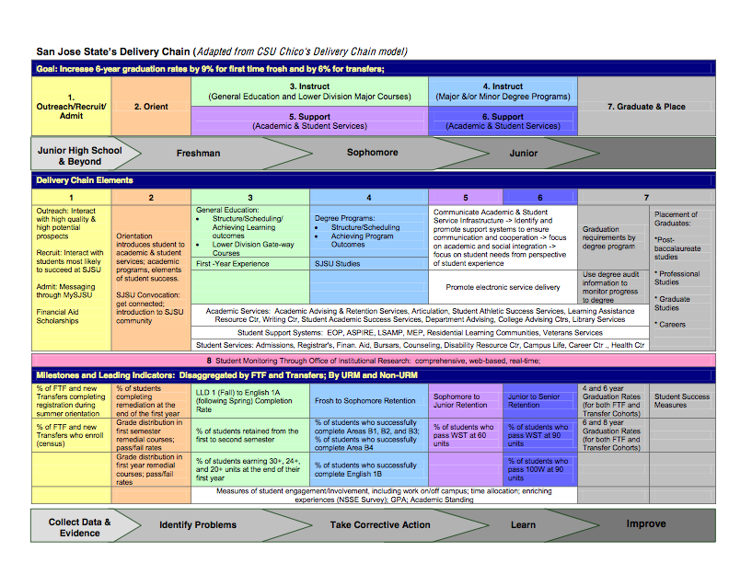

Slide 20
Santa Ana College
Professional/ Personal Development
Reverse Transfer
High School
Continuing Education
Adult Learner
Returning Learner
Santa Ana College
Degree Attainment
(AA, AS, Certificate)
4 Yr. University
Other 2 Yr.
College
Stop Out
For Profit
Job Placement

Slide 21
Santa Ana College
Latina/o - high personal self-concept, low academic self-concept compared to Latinos in PWI
Need for more counseling and tutoring
DLE data will influence practice, hiring, funding allocation for services that support student success
Economic challenges & family responsibilities persist
Lessons learned: Can’t take compositional diversity for granted, need to facilitate conversations for development and success

Slide 22
Conclusion
Shifting national conversation to broad access and diverse institutions
Research tools to assess and improve retention and graduation
Value-added models

Slide 23
Questions/ Discussion
Contact Information
Higher Education Research Institute
www.heri.ucla.edu
Diverse Learning Environments
www.heri.ucla.edu/dle
HIGHER EDUCATION RESEARCH INSTITUTE AT UCLA
home of the COOPERATIVE INSTITUTIONAL RESEARCH PROGRAM

