Slide 1

Diverse Learning Environments: A New Assessment and Plan of Action to Transform Campus Climate
Sylvia Hurtado, Cynthia Lua Alvarez, Chelsea Guillermo-Wann
23rd Annual NCORE
National Harbor, Maryland
June 3, 2010

Slide 2
Overview
Purpose, Goals, & Key Features of Project
Developing the DLE Conceptual Framework
A New Assessment: Diverse Learning Environments Survey
Action Plan to Transform Campus Climate

Slide 3
Purpose, Goals,
& Key Features
of the DLE Project

Slide 4
Purpose & Goals
Purpose:
  Assist educators in advancing the success of diverse students
Goals:
  Develop a greater awareness about diversity, student learning, and student success
  Assess undergraduate skills for work and citizenship in a pluralistic democracy
  Increase retention rates and improve the assessment of retention
  Create the conditions for realizing the benefits of diversity in the learning process

Slide 5
Key Features of the Project
Research:
  Diverse Learning Environments Survey
  Campus Case Studies of 8 Institutions
  National Retention Study (Clearinghouse)
Practice:
  Institute for the Critical Analysis
  of Quantitative Data
  Diversity Research Institute

Slide 6
Developing the
Diverse Learning Environments
Conceptual Framework

Slide 7
Student Success Outcomes
Habits of Mind/Skills for Lifelong Learning
Competencies for a Multicultural World
Achievement and Retention

Slide 8
Foundational Frameworks
Institutional Adaptation to Student Diversity Richardson & Skinner (1990)
Campus Climate for Diversity
    Hurtado, Milem, Clayton-Pedersen & Allen (1998, 1999)
    Milem, Chang & Antonio (2005)
Student/Institution Engagement Model
Nora, Barlow & Crisp (2005)
Dynamics of Multicultural Teaching & Learning
    Marchesani & Adams (1992) adaptation of Jackson (1988)

Slide 9
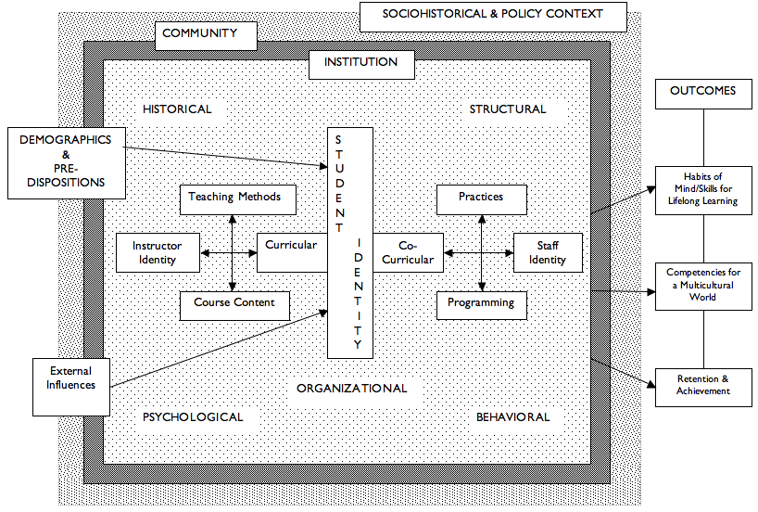
DLE Conceptual Framework

Slide 10
A New Assessment:
Diverse Learning
Environments Survey

Slide 11
Unveiling the DLE Instrument
Integrated assessment of climate, diversity practice, and outcomes
Inclusive of diverse social identities
Modules targeting specific topics
Longitudinal when linked with other student data (e.g. registrar data)
Nationally available CIRP survey in the future

Slide 12
DLE Survey Components
Core Survey
Modules
  Classroom Climate
  Transition into the Major
  Intergroup Relations
  Community College Students’ Transfer Pathway
  Transition Experiences for Transfer Students at 4-year Institutions

Slide 13
Items Addressing Diverse Social
Identity Groups in Core Survey
General diversity: 50
Race/ethnicity: 42
Gender: 15
Socioeconomic
class: 18
Age: 4
Sexual Orientation: 9
Ability/Disability: 7
Political Orientation: 10
Religion/spirituality: 7
Citizenship: 6

Slide 14
Construct:
Effects of Economic Context
I may have to choose between financially supporting my family and going to college
I am facing more financial difficulty this year
Felt concerned about my ability to finance my college education
The current economy has lead me to question my major choice

Slide 15
Construct:
General Validation
Faculty empower me to learn here
At least one staff member has taken an interest in my development
Faculty believe in my potential to succeed academically
Staff encourage me to get involved in campus activities
Staff recognize my achievements
At least one faculty member has taken an interest in my development

Slide 16
Construct:
Validation in the Classroom
Instructors were able to determine my level of understanding of course material
Instructors provided me with feedback that helped me judge my progress
I feel like my contributions were valued in class
Instructors encouraged me to meet with them after or outside of class
Instructors encouraged me to ask questions and participate in discussions
I received recognition for my academic work

Slide 17
Construct:
Student Enrollment Mobility
Considered taking a course at another institution
Taken a leave of absence from this college temporarily
Taken a course from another institution while taking classes here
Considered leaving this institution permanently
Taken a summer course at another institution
Taken an online course from another institution
Considered transferring to another institution
Taken a course from another institution while not taking classes here
It will take me longer to graduate than I had planned
If offered a job in my field before I finish my degree I would stop attending college

Slide 18
Race/Ethnicity Question
CIRP (9 categories)
  White/Caucasian
  African American/Black
  American Indian/Alaska Native
  Asian American/Asian
  Native Hawaiian/Pacific Islander
  Mexican American/Chicano
  Puerto Rican
  Other Latino
  Other
DLE (62 categories)
Arab American:
Egyptian
Iraqi
Lebanese
Palestinian
Syrian
Arab/Arabic
Middle Eastern
Persian
Other
Native Hawaiian/Pacific Islander:
Samoan
Guamanian/Chamorro
Tongan
Fijian
Other
Asian American/Asian:
Cambodian
Chinese
Taiwanese
Japanese
Hmong
Laotian
Bangladeshi
Indonesian
Sri Lankan’
Indian
Korean
Malaysian
Pakistani
Latina/o:
Cuban
Puerto Rican
Central American
Mexican-American/
Chicano
South American
Hispanic
Other
White/Caucasian:
Australian
British
Canadian
French
German
Irish
Italian
Polish
Russian
Scottish
Other European
Black:
African American
Ethiopian
Ghanaian
Nigerian
South African
Other African
Haitian
Jamaican
Trinidadian
Other West Indian
Other
Native American/American Indian/Alaska Native:
Tribe__________

Slide 19
DLE Administration & Sample
End of pilot phase: June 30, 2010
15 Institutions Registered for Pilot Phase
Two-Year Institutions
Full cohorts
Students who have completed 24 units or more at the institution
Inclusive of vocational and academic paths
Inclusive of all degree aspirations (not transfer-bound only)
Four-Year Institutions
Full cohorts
Students in their sophomore year (were 1st time freshman in fall 2008)
Students in their junior year (were 1st time freshman in fall 2007)
Transfer students who have completed one year at the institution

Slide 20
Deliverables for Institutions
Data for all student responses
Reports
  Institutional Profile
  Frequencies, means, standard deviations
  CIRP Constructs
  CIRP Themes
  Comparison Groups (if 5 or more institutions in comparison group)
Recommendations of strategies to increase student success and retention for institutions

Slide 21
Action Plan

Slide 22
Key Considerations:
Have a Plan for
Ownership & Responsibility
Conducting Research:
Wide involvement for input on challenges
Different approaches for constituencies (e.g. faculty, staff, students)
Use of data and stories
Capitalize on those interested in this work
Studies on similar campuses
Use Information for Practice:
Dissemination of information (e.g. Summit)
Use converging evidence (multiple sources) for solutions
Writing recommendations and next steps
Prepare those who have the responsibility for implementation of change

Slide 23
Increasing the Participation of Marginalized Groups
Most marginalized are least likely to participate
  Work with communities, student organizations, centers (e.g. use peers, centers)
  Emphasize participation as part of institutional self-study and change
  “Face-to-face” contact or personalized email survey
  Incentives – drawing for tuition/fees, parking pass, books, etc. or small incentive for each student

Slide 24
Increasing Response Rates
Inform your IT department
Send out advanced notification to students either through an email, campus announcement, class announcement, student web portal, etc.
Customize survey as much as possible
Send email using an email account familiar to students
Send reminder emails and keep track of responses

Slide 25
Determining Key Steps
Given campus goals/issues and frameworks, determine the key steps that need to occur to incorporate more research about diversity on campus:
What are the desired outcomes? What information do we need most and from which constituency? (Units, faculty, students)
Who else needs to be at the table on campus? What expertise do we need?
How do we encourage the participation of students, staff, faculty?
How will we disseminate the information to ensure it is used to promote progress/change on campus?

Slide 26
Resources & Questions
Higher Education Research Institute
http://www.heri.ucla.edu
Diverse Learning Environments Project
Website: http://heri.ucla.edu/dle
Email: dleproject@gseis.ucla.edu
Phone: 310-267-5930

