Slide 1
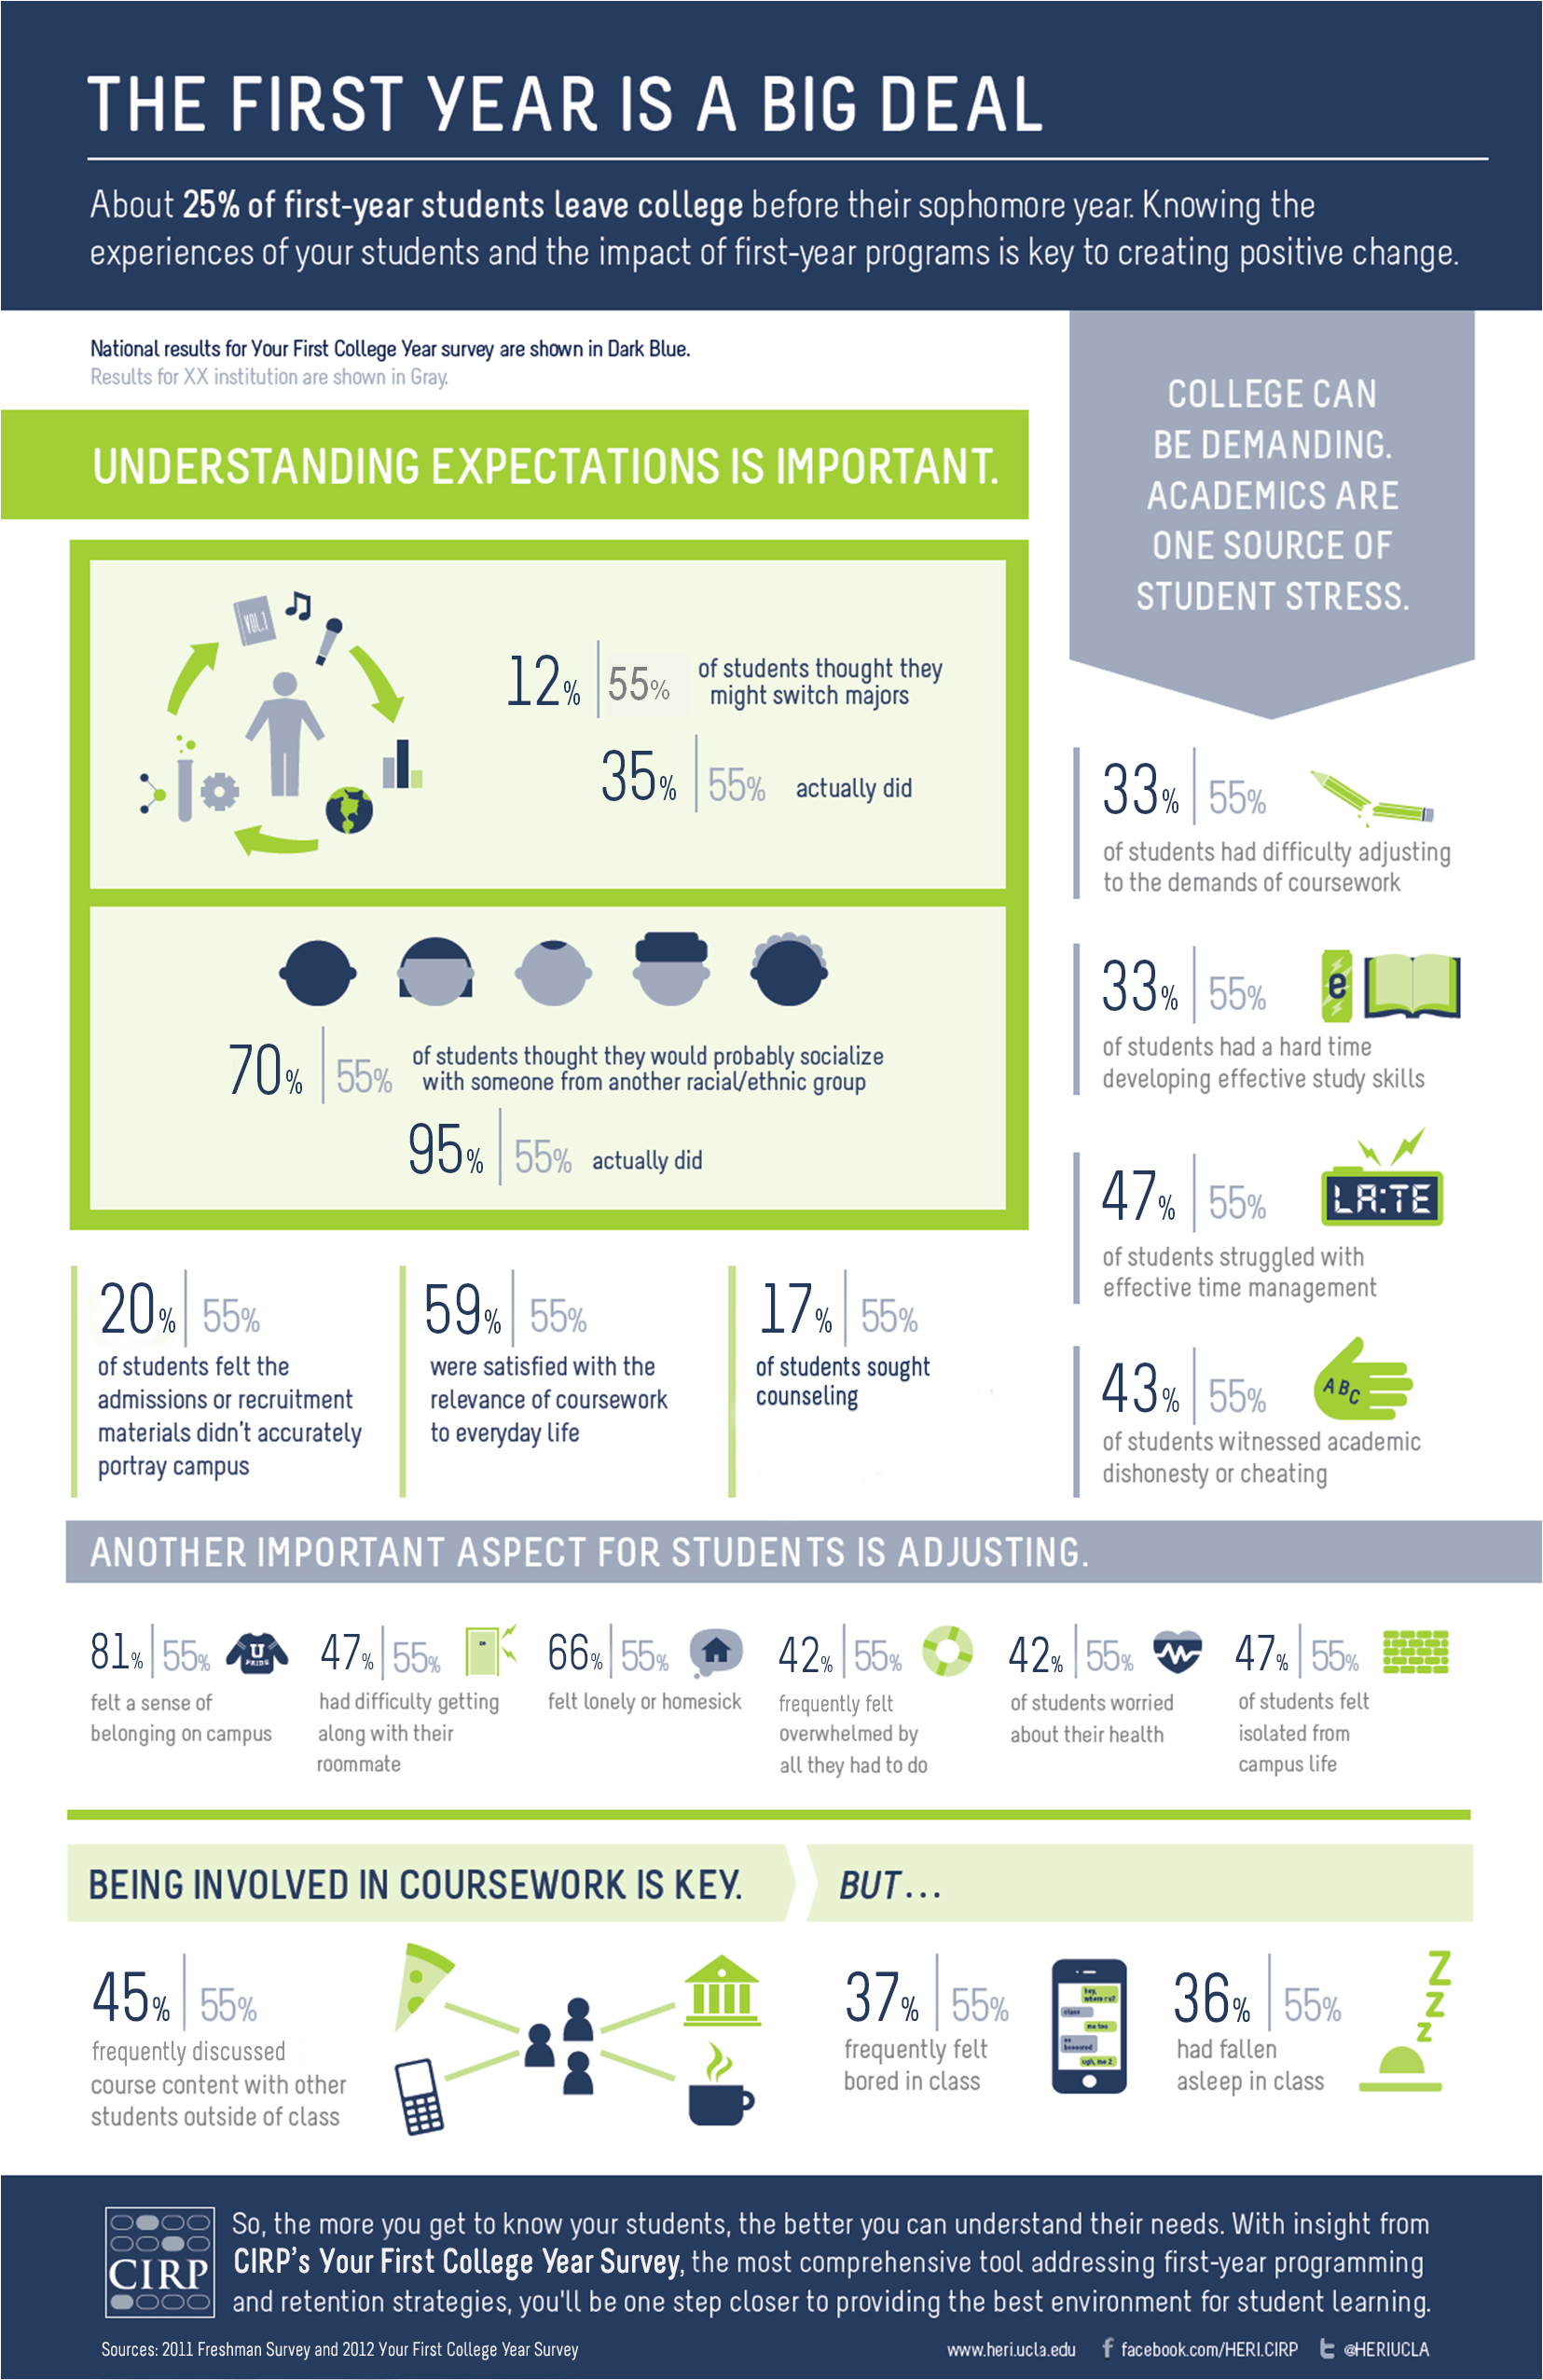
Results for XX institution are shown in Grey
55%
55%
55%
55%
55%
55%
55%
55%
55%
55%
55%
55%
55%
55%
55%
55%
55%
55%
55%
55%

